Slide 1

AIBridge
Lecture 4

Slide 2
Classification!
quick review
wine dataset
Fixed acidity
Volatile acidity
Citric acid
Residual sugar
Chlorides
Free sulfur dioxide
Total sulfur dioxide
Density
pH
Sulphates
Alcohol
a class
White = 0
Model
Red = 1
categorical label outputs are named “classes”
2
Notes:
Let’s quickly review what classification is, using the wine dataset. Each output category is a class (which is why it’s called classification)

Slide 3
Classification!
quick review
that’s a lot of features!
wine dataset
Fixed acidity
Volatile acidity
Citric acid
Residual sugar
Chlorides
Free sulfur dioxide
Total sulfur dioxide
Density
pH
Sulphates
Alcohol
a class
White = 0
Model
Red = 1
categorical label outputs are named “classes”
3
Notes:
We have some features. (in this case we have 11)

Slide 4
Fixed acidity
Volatile acidity
Citric acid
Residual sugar
Chlorides
Free sulfur dioxide
Total sulfur dioxide
Density
pH
Sulphates
Alcohol
Linear models might not be the best in some cases
4
Notes:
But that’s a lot of features! And as you have more and more features with complex data, linear models (such as linear or logistic regression) might not be the best.

Slide 5
Decision Trees
5
Notes:
Our first model is a decision tree.

Slide 6
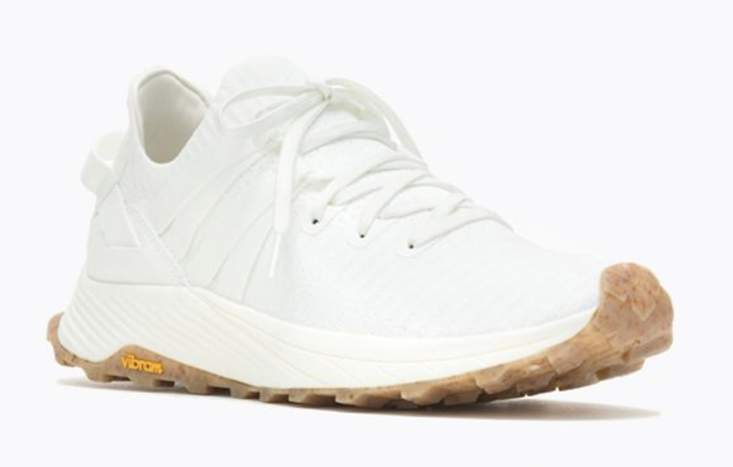
Decision Trees
6
Notes:
To understand this model, let’s take a look at an example. Let’s say you want to buy a pair of shoes.

Slide 7
Decision Trees
Can I afford it?
7
Notes:
You want to know its price,

Slide 8
Decision Trees
Can I afford it?
Is it comfortable?
8
Notes:
Comfort level,

Slide 9
Decision Trees
Can I afford it?
Is it comfortable?
Is it fashionable?
9
Notes:
And fashion level.

Slide 10
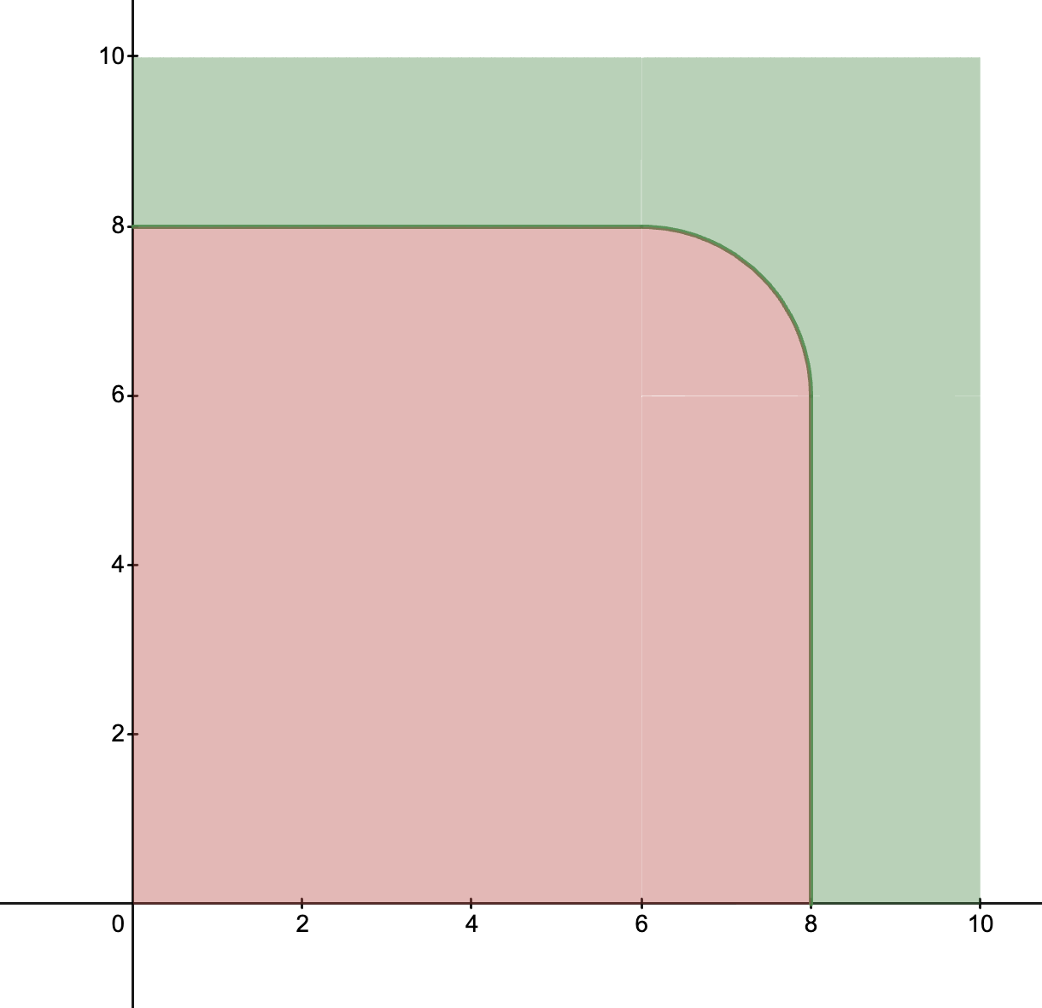
Decision Trees
Can I afford it?
Is it comfortable?
Comfort
Is it fashionable?
Fashion
10
Notes:
This might be a graph of shoes you would buy, and if a shoe lands in the green area, you buy it. A linear model isn’t really going to work here.

Slide 11




Decision Trees
Can I afford it?
No
Don’t buy
Yes
Is it comfortable?
Yes
No
Buy
Is it fashionable?
Yes
No
Buy
Don’t buy
11
Notes:
Here we have a flowchart of decisions. For example, if we have an affordable, uncomfortable, but fashionable shoe, then we would buy it (POINT OUT PATH)
TAKE QS

Slide 12
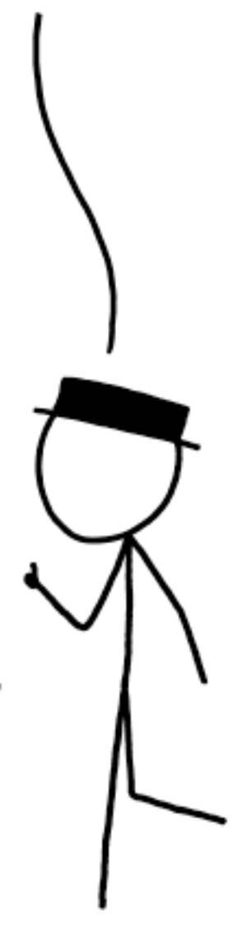
Decision Trees
Price ≤ $100?
No
Don’t buy
that seems awfully hard-coded!
Yes
Comfort ≥ 8?
flowcharts of decisions can create an explainable and repeatable graph of predictions
Yes
No
Buy
Fashion ≥ 8?
Yes
No
Buy
Don’t buy
12
Notes:
Let’s just set some more concrete questions here. But this seems quite hard coded. How do we make a computer automatically do this?
Practice more

Slide 13
Decision Trees
Price
Comfort
Fashion
Purchased?
$70
4
6
No
$120
5
8
No
$20
4
4
No
$60
1
8
Yes
$60
6
3
No
$80
8
8
Yes
13
Notes:
Here, we have some sample data, of possible shoes and purchased status. Let’s just look at the purchased status for now.

Slide 14
Decision Trees
Purchased?
No
No
No
Yes
No
Yes
14
Notes:
Each question has two possible answers, (yes and no) so you can think of a question as splitting a group of samples (shoes) into two groups. Let’s look at some possible splittings.

Slide 15
Decision Trees
No
Yes
No
No
No
Yes
15

Slide 16
Decision Trees
No
Yes
No
No
No
Yes
16

Slide 17
Decision Trees
Which one is a better split?
(when trying to automate Decision Trees)
No
No
Yes
No
No
No
No
No
Yes
No
Yes
Yes
All no
Mostly no
17
Notes:
Here, we have two splits. But which one is better?
PAUSE
The right one is better, but why? (MAY VARY BASED ON ANSWERS) It’s because we have a group that is all no. And we can tell a computer that. Using Gini Impurity.

Slide 18
Decision Trees
Gini impurity
Purchased?
Purchased?
No
No
0
No
No
0.38
No
No
Yes
Yes
0.44
No
No
0.5
Yes
Yes
as a group becomes more homogeneous, its Gini Impurity decreases.
18
Notes:
When a group becomes more homogenous (the same throughout) its gini impurity decreases. And the best splitting results in the lowest gini impurity.

Slide 19
Decision Trees
Gini impurity
Purchased?
Purchased?
No
No
0
No
No
0.38
No
No
Yes
Yes
0.44
No
No
0.5
Yes
Yes
as a group becomes more homogeneous, its Gini Impurity decreases.
perfect groups => 0 Gini Impurity => 100% predictions
19
Notes:
Perfect groups (all of one answer) will have 0 Gini Impurity, meaning that you can predict the answer 100% of the time.

Slide 20
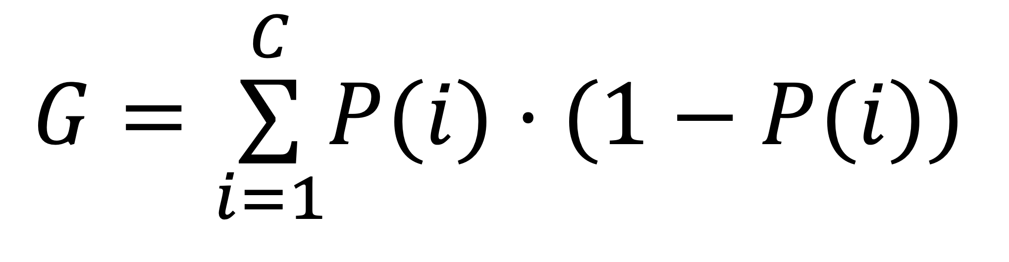
Decision Trees
Gini impurity
Fraction of that one class in group
Fraction of not that one class in the group
$$G=\overset{C}{\underset{i=1}{∑}}P(i)⋅(1−P(i))$$
Add them up for all classes
(in one side of the split)
Gini impurity measures the homogeneity in a group
20

Slide 21
Decision Trees
Purchased?
No
0
No
No
Yes
0.5
No
Yes
0.5
21
Notes:
Let’s look back at some possible splittings.

Slide 22
Decision Trees
Purchased?
No
No
0.38
No
Yes
No
0.5
Yes
0.88
22

Slide 23
Decision Trees
we gotta do better than this, right?
Purchased?
No
No
0
No
Yes
No
0.44
Yes
0.44
23
Notes:
We aren’t doing great with these splits (remember that splits are based on the features which may not cooperate)

Slide 24
Decision Trees
Purchased?
No
No
0
just split again!
No
Yes
No
0.44
Yes
0.44
24
Notes:
So we just split again!

Slide 25
Decision Trees
Make splits (using features and thresholds)
Calculate Gini impurities
Select the split that results in the lowest Gini impurity sum
If unhappy, just split again!
Repeat 1-4 as much as needed
a hyperparameter
25
Notes:
So our program looks like this. We can also tell the program to limit the maximum number of splits. That’s what decision trees do.
TAKE QS

Slide 26
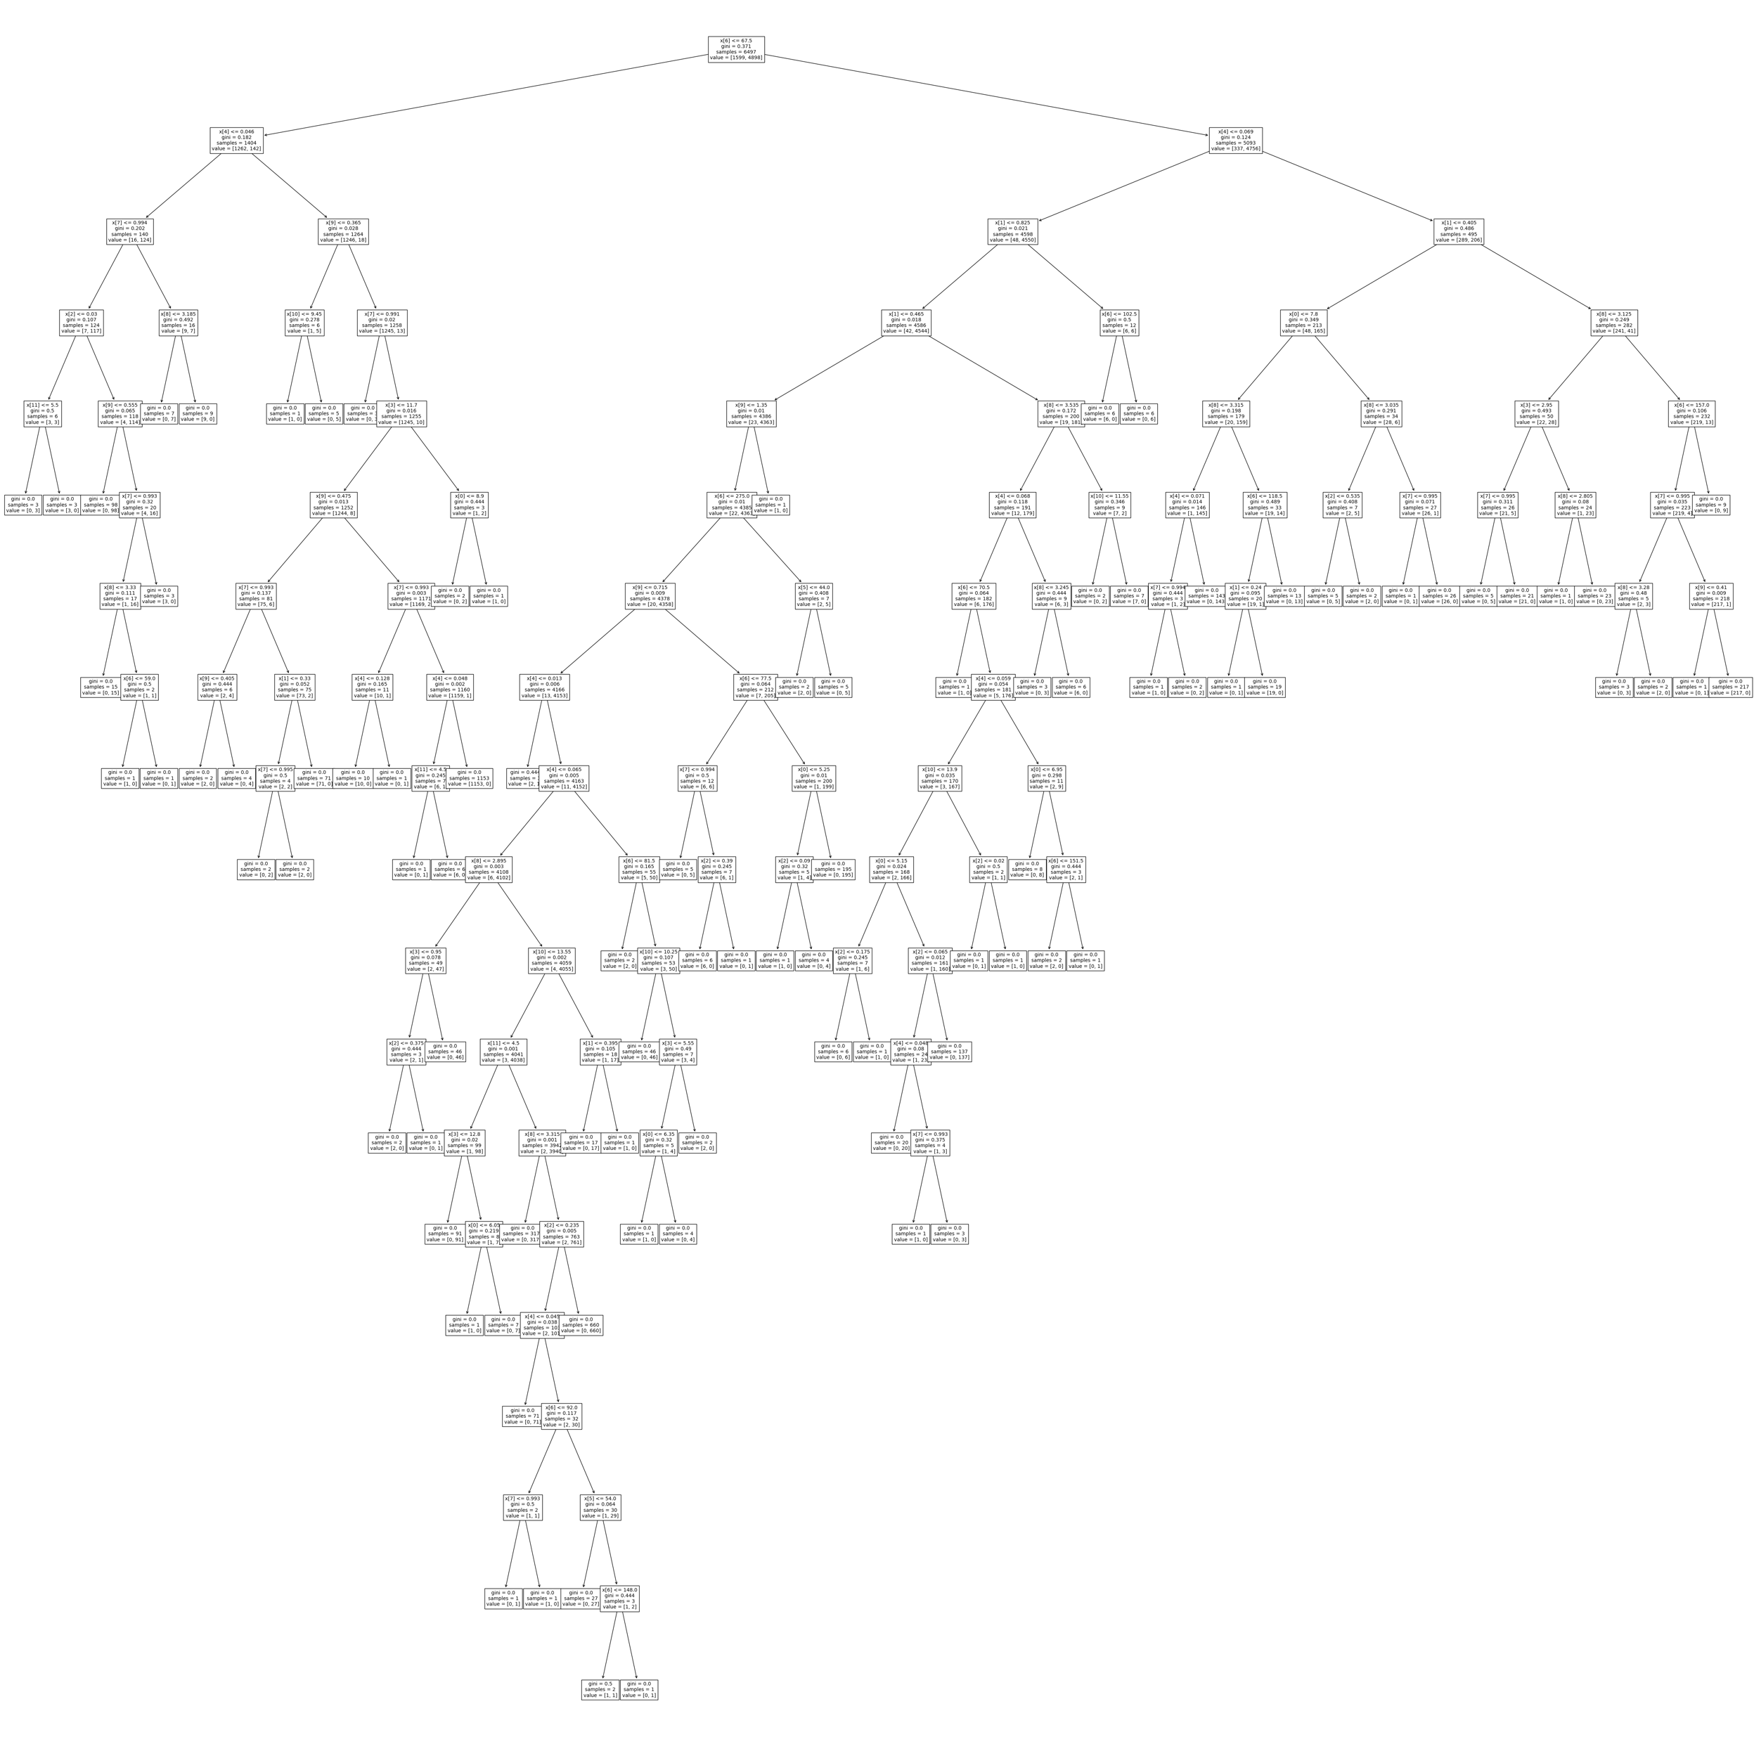
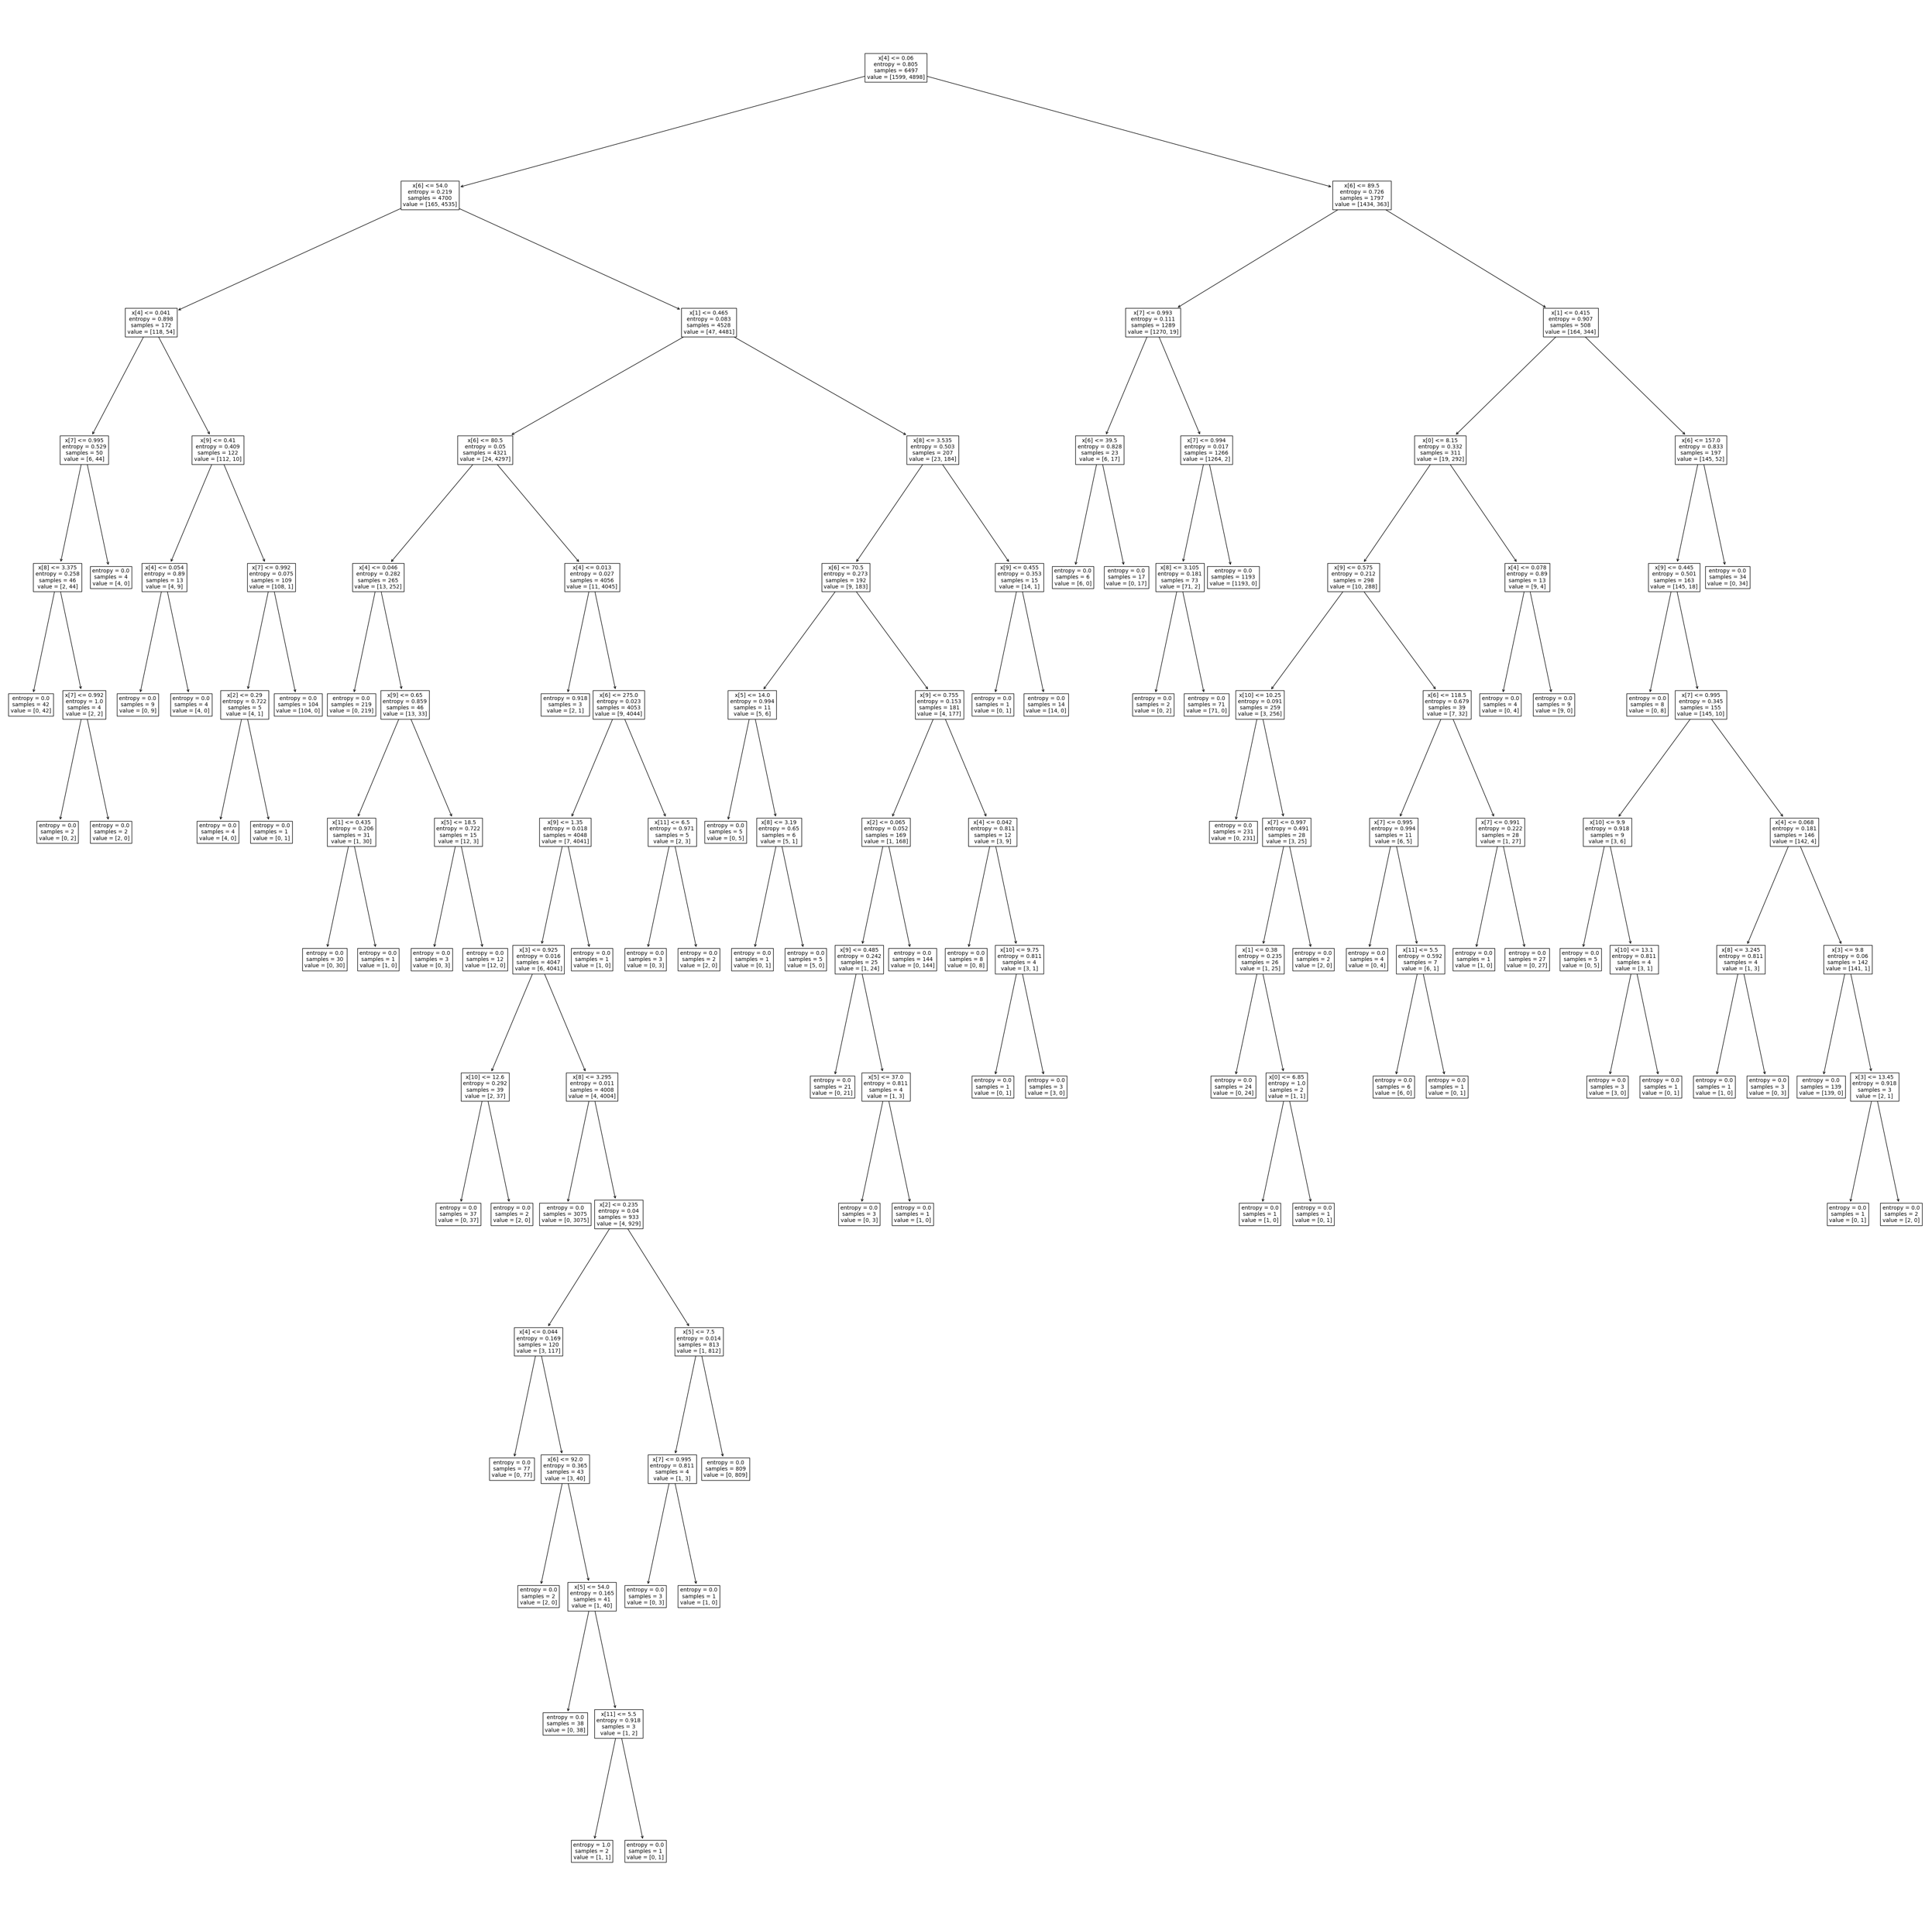
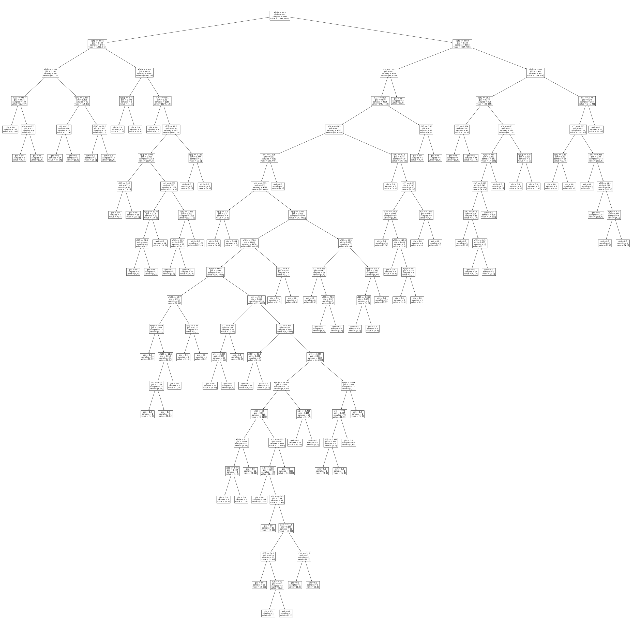
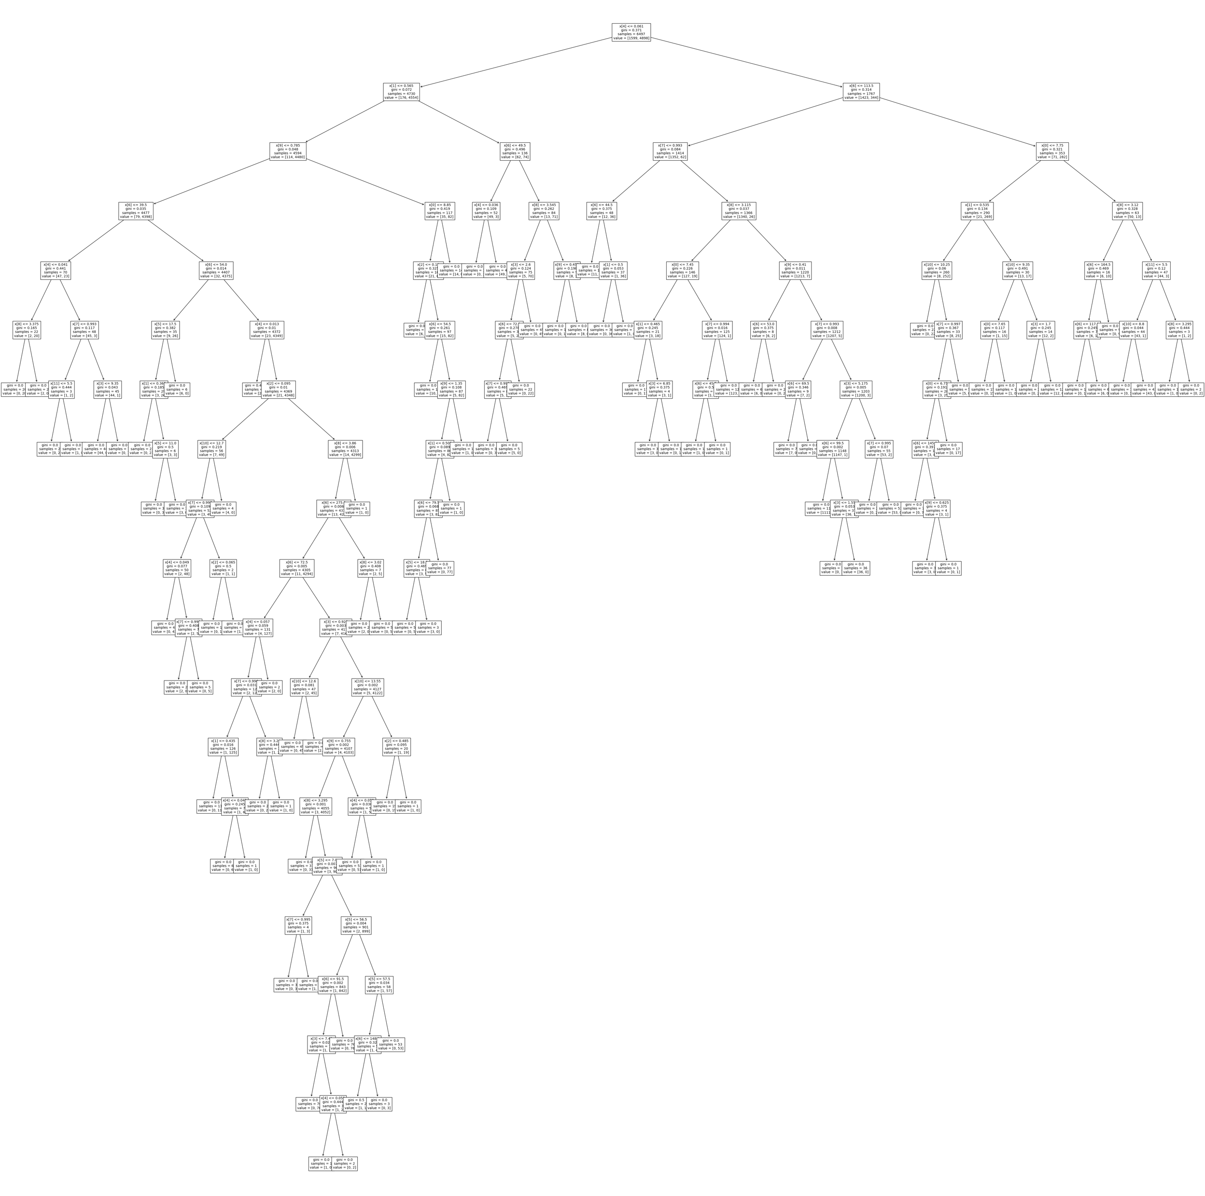
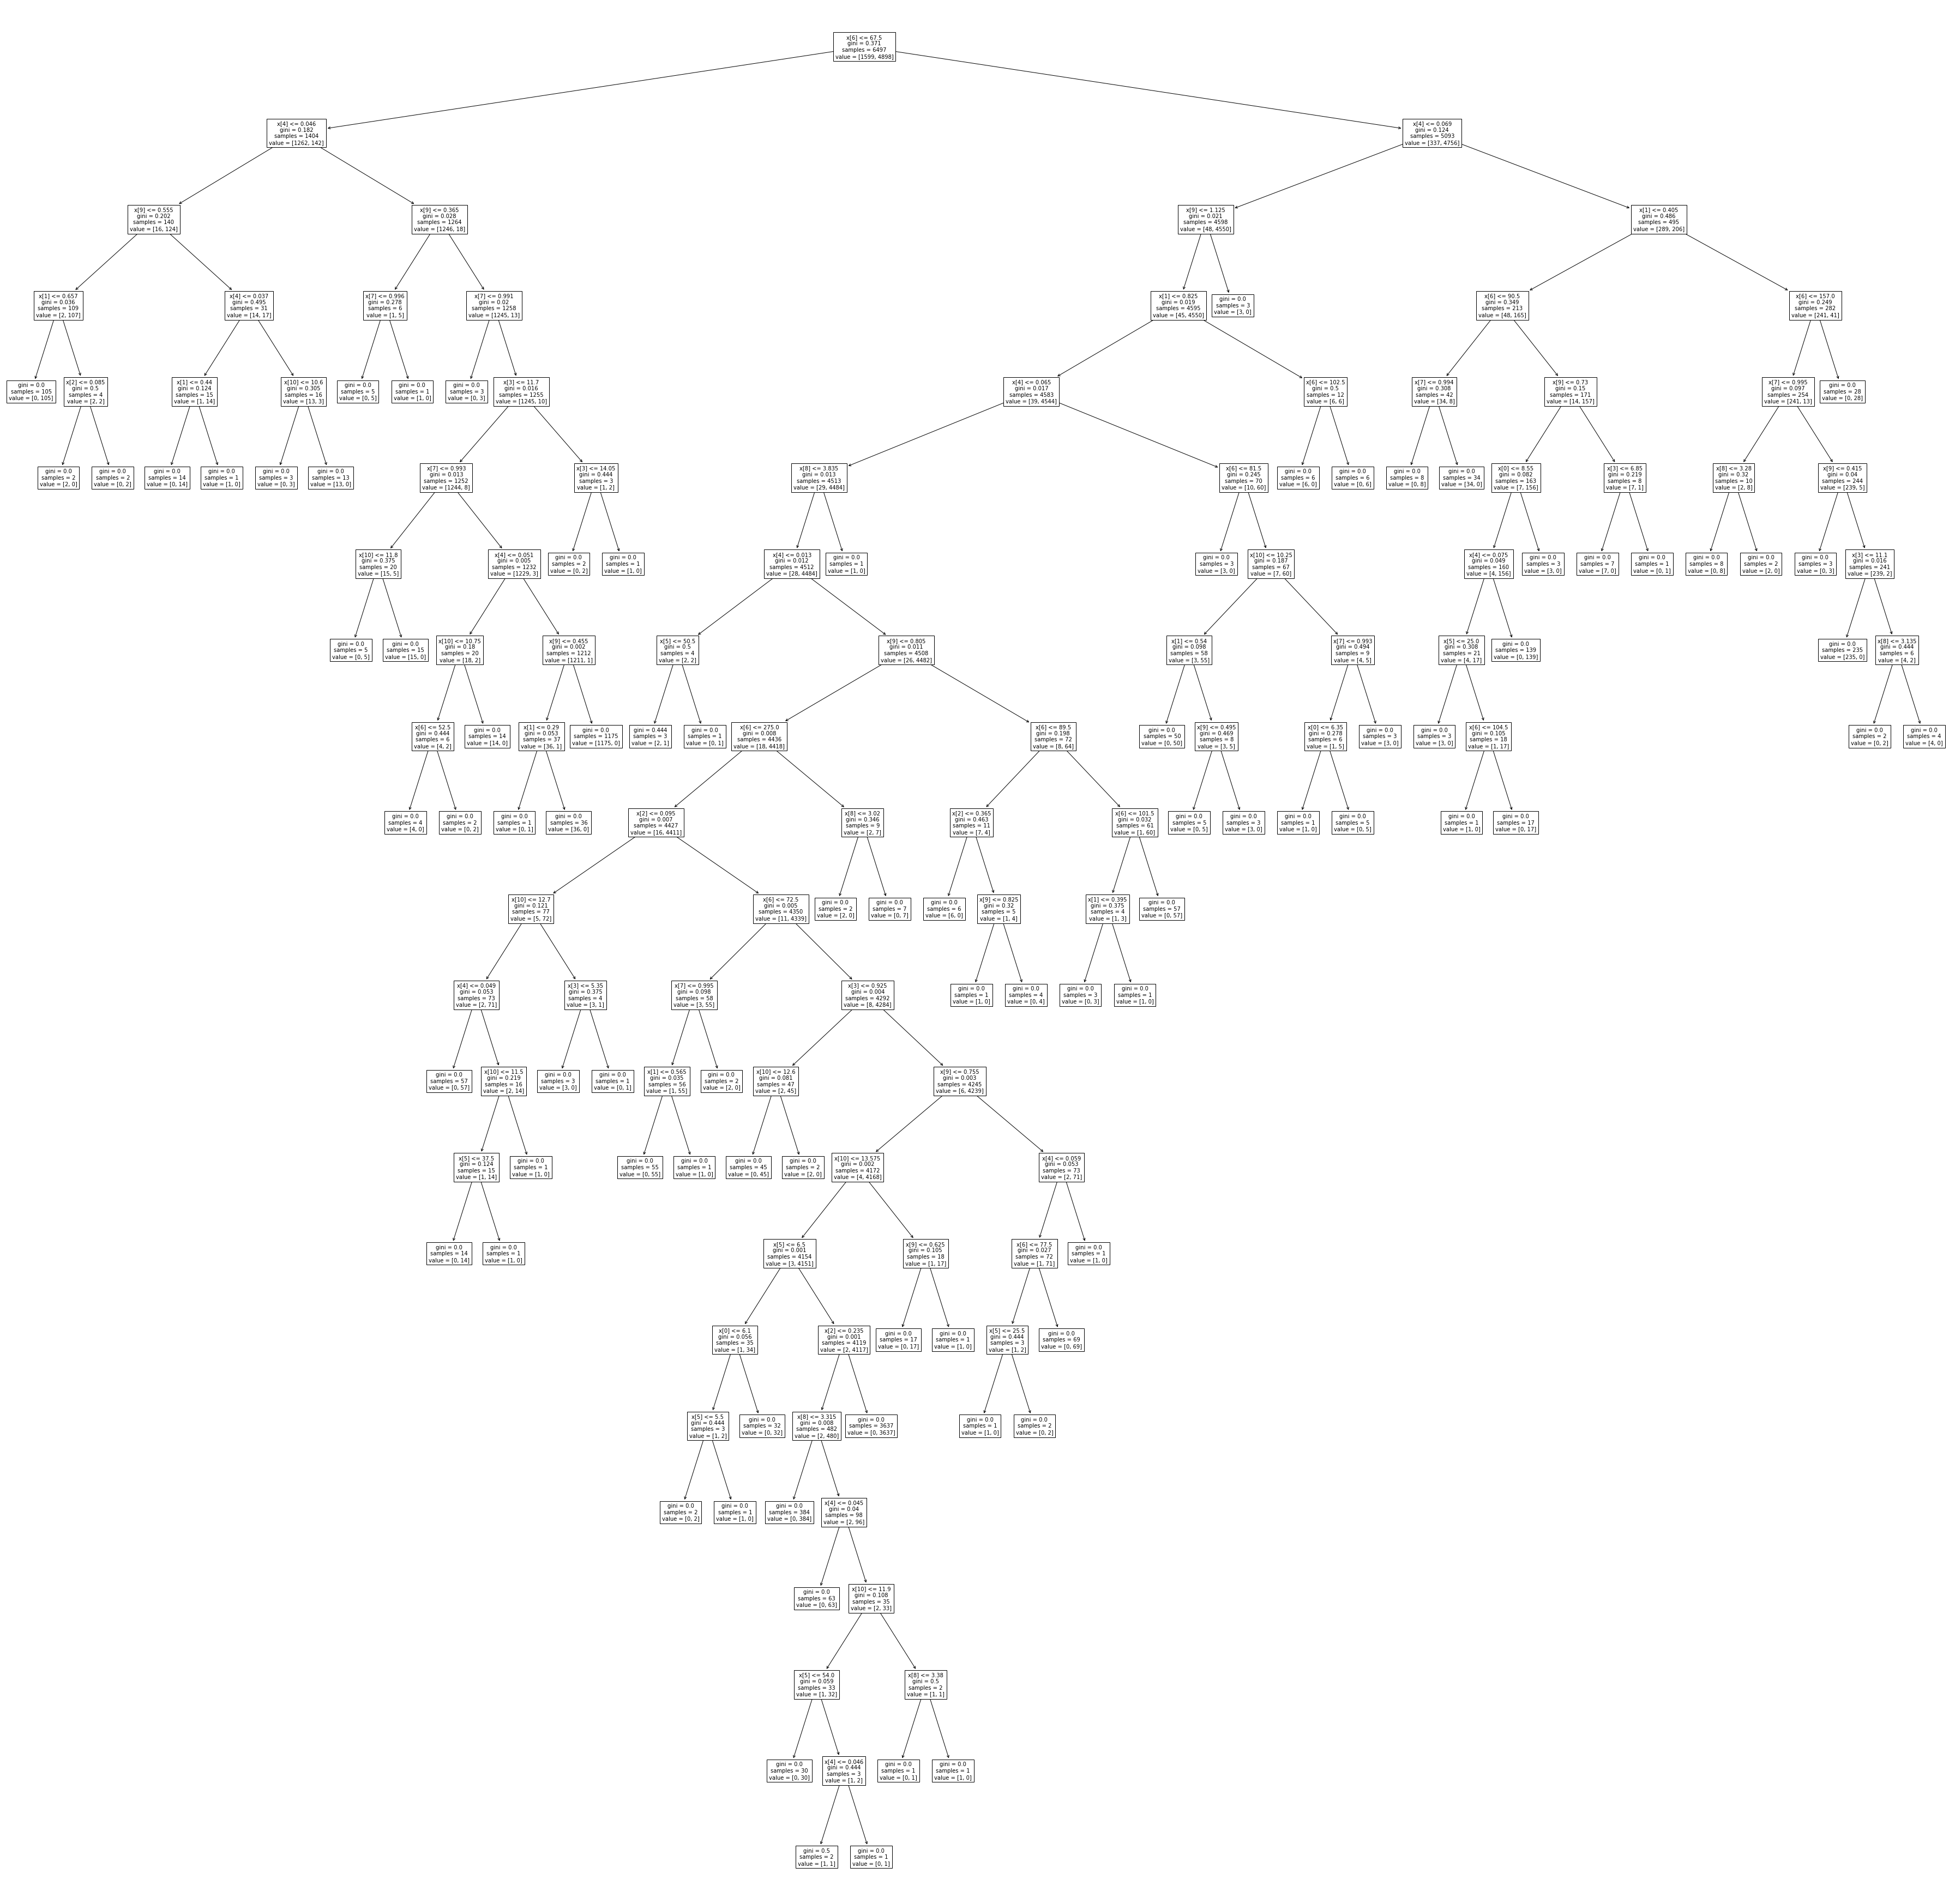
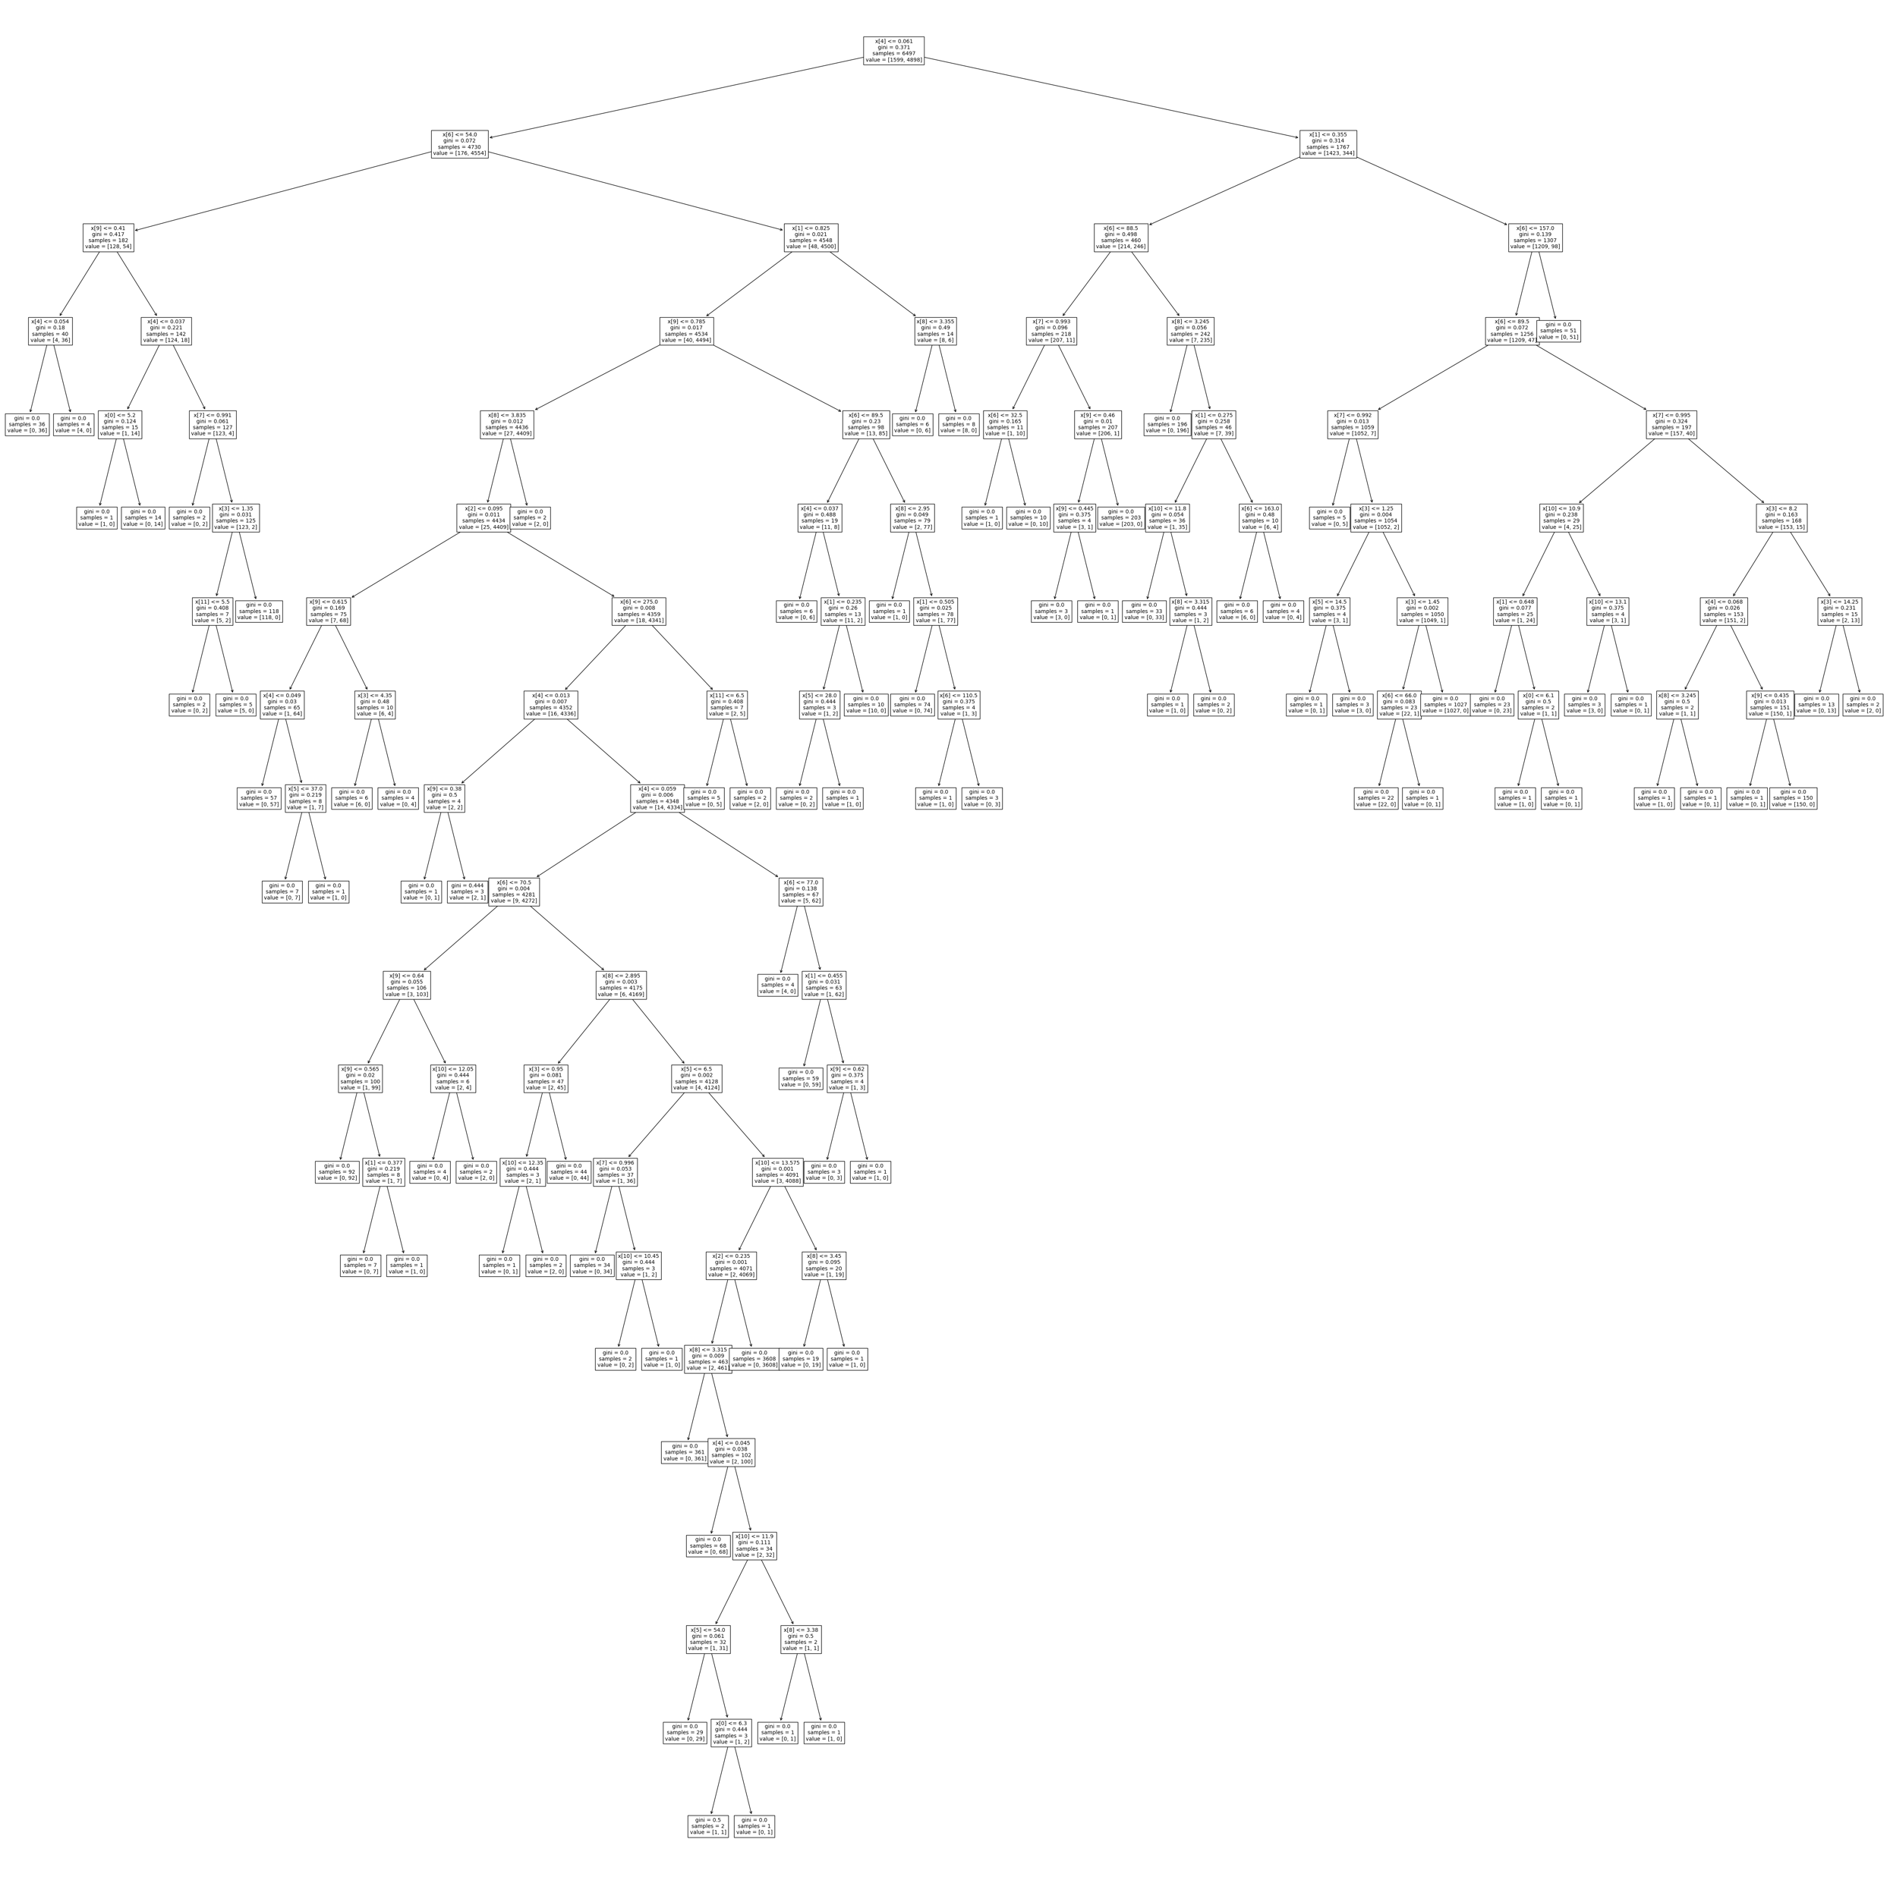
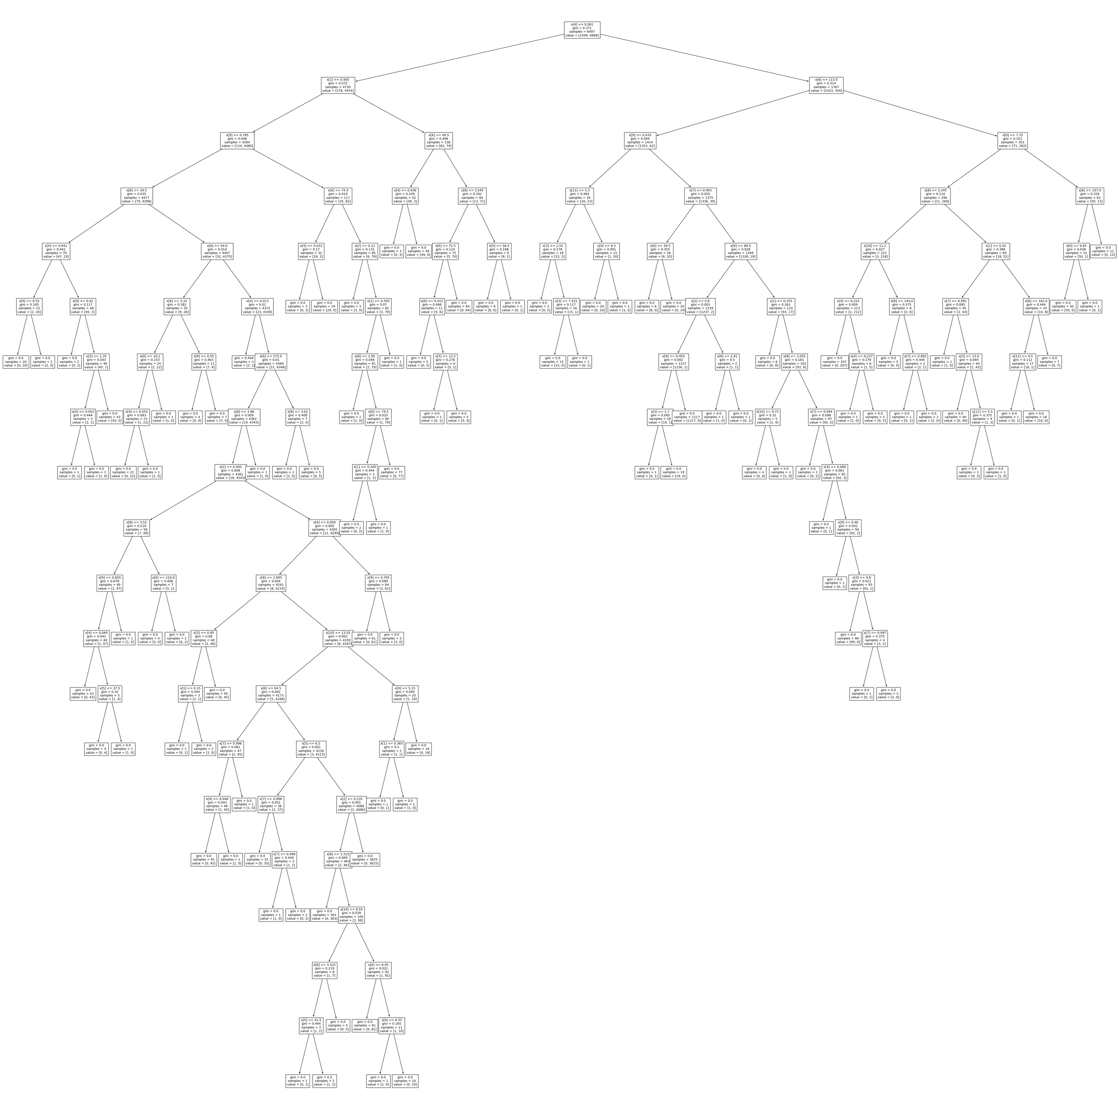
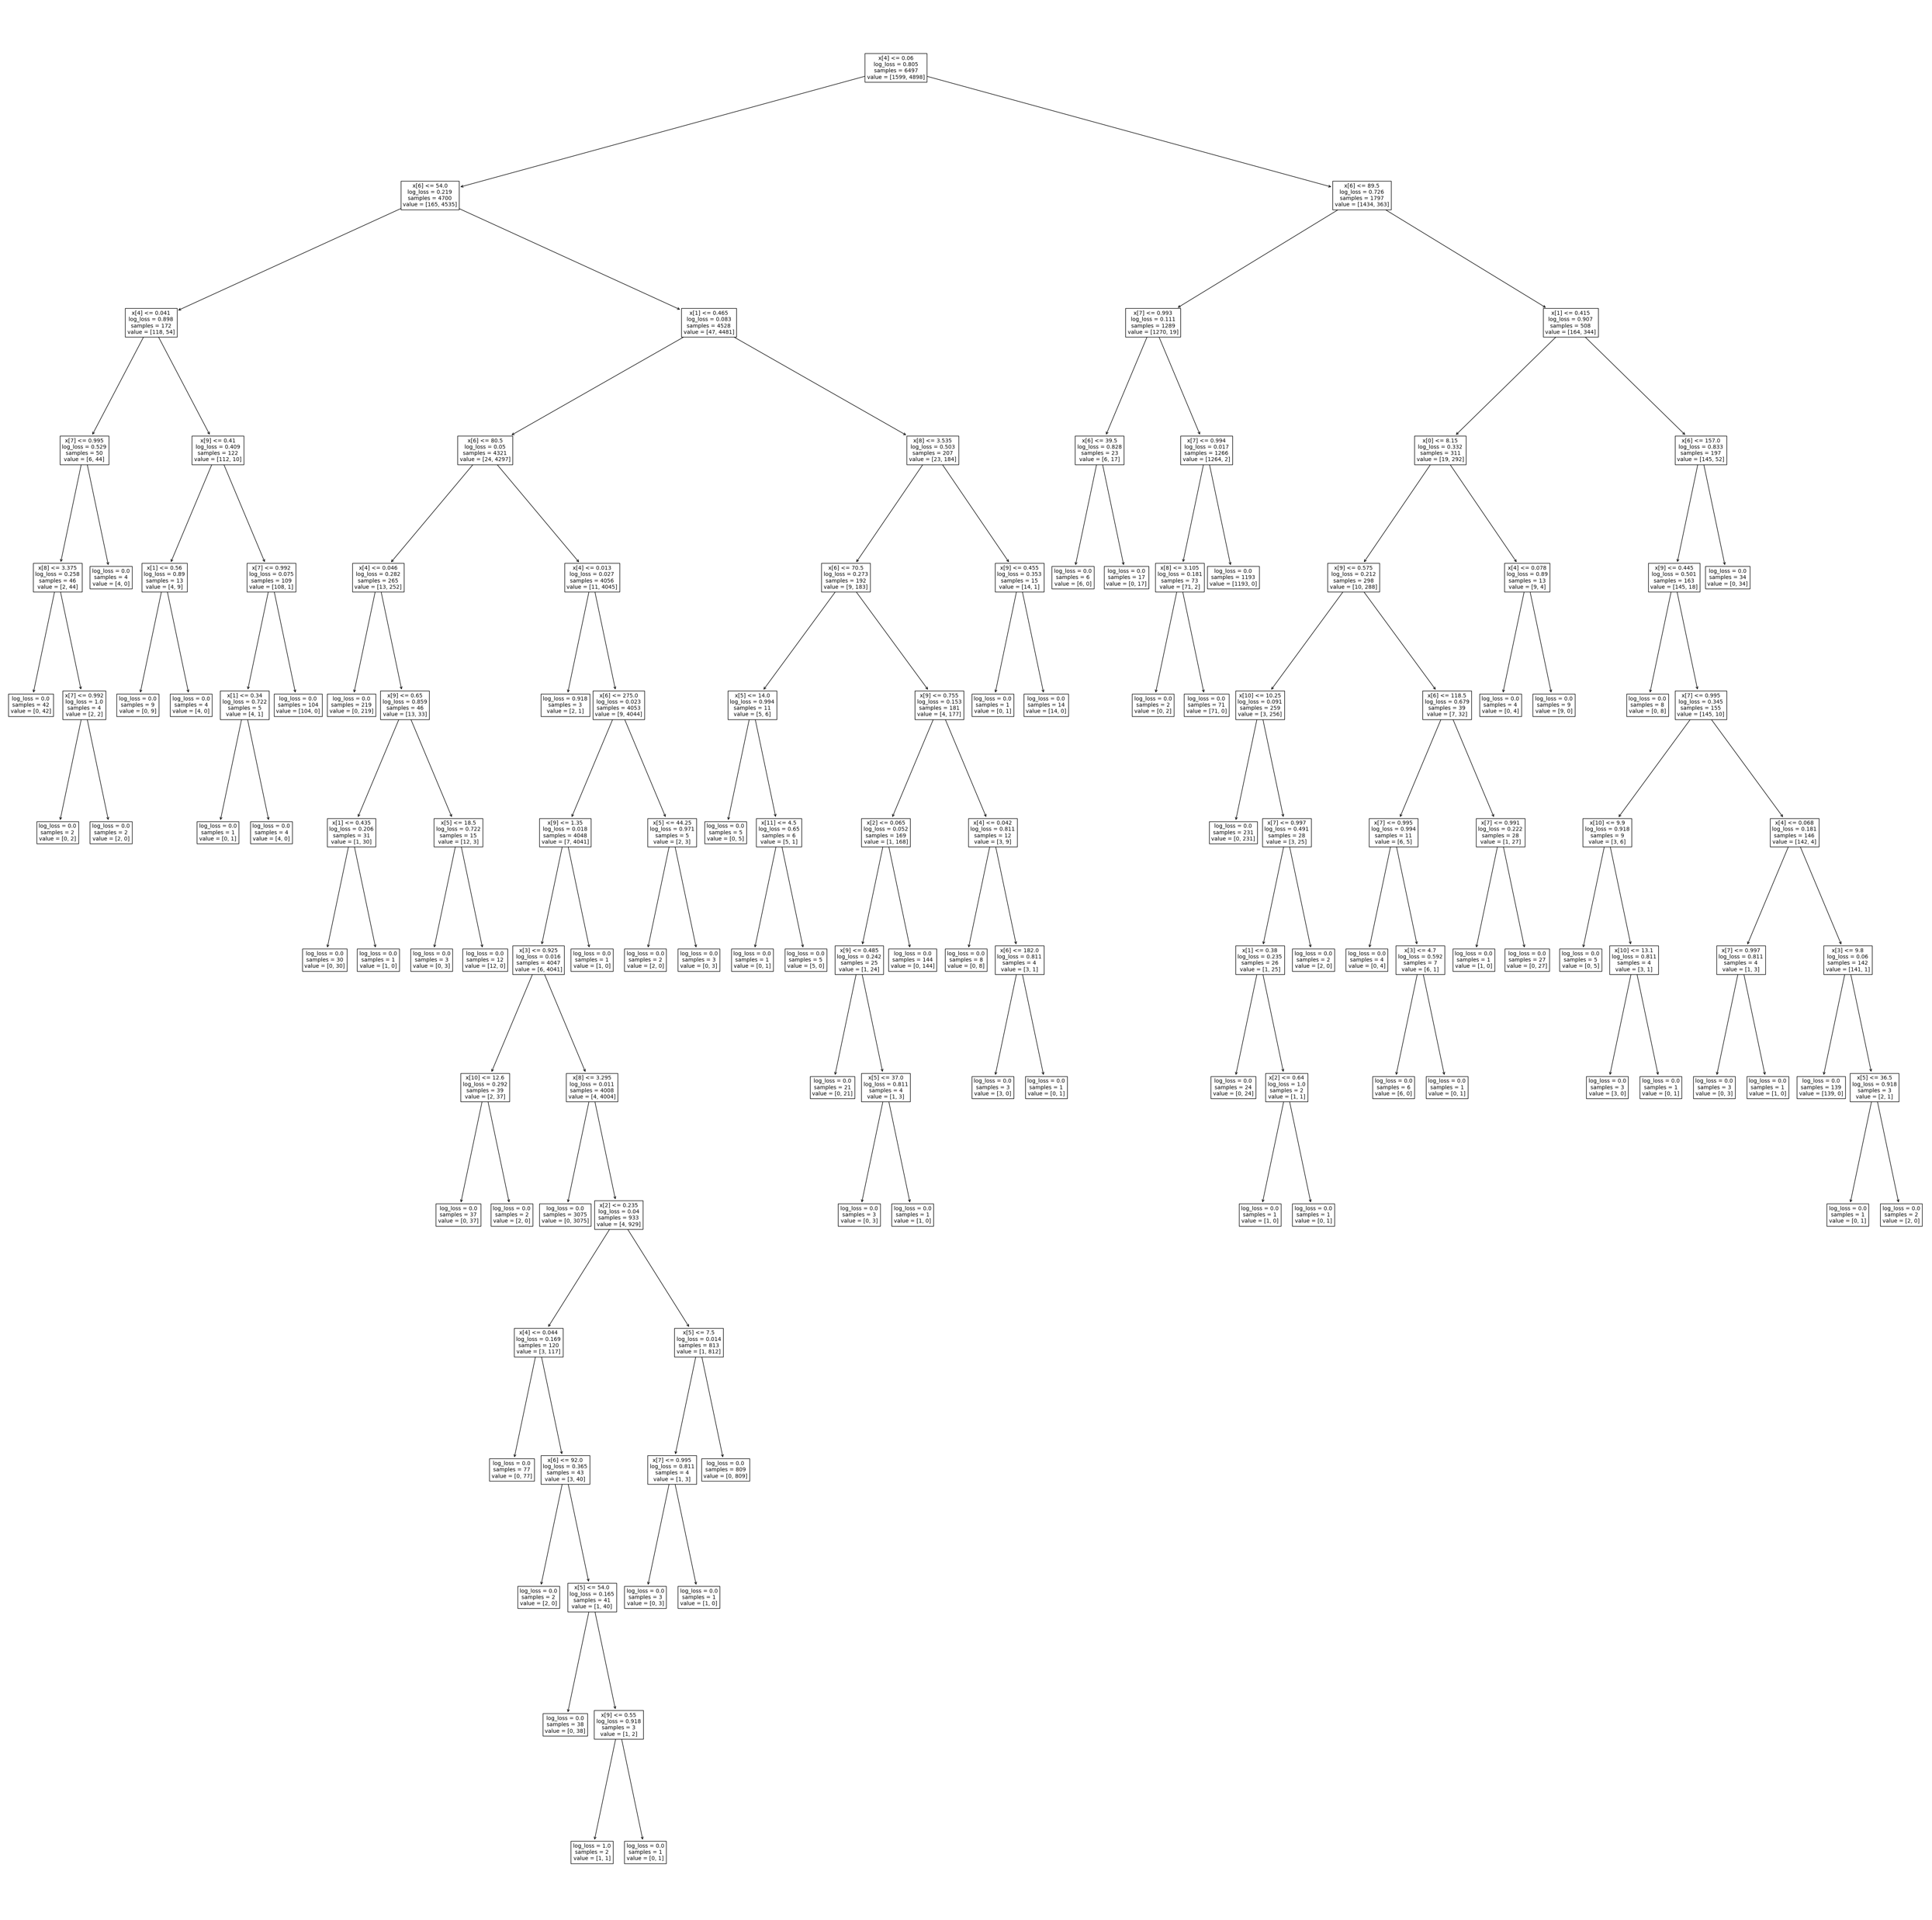
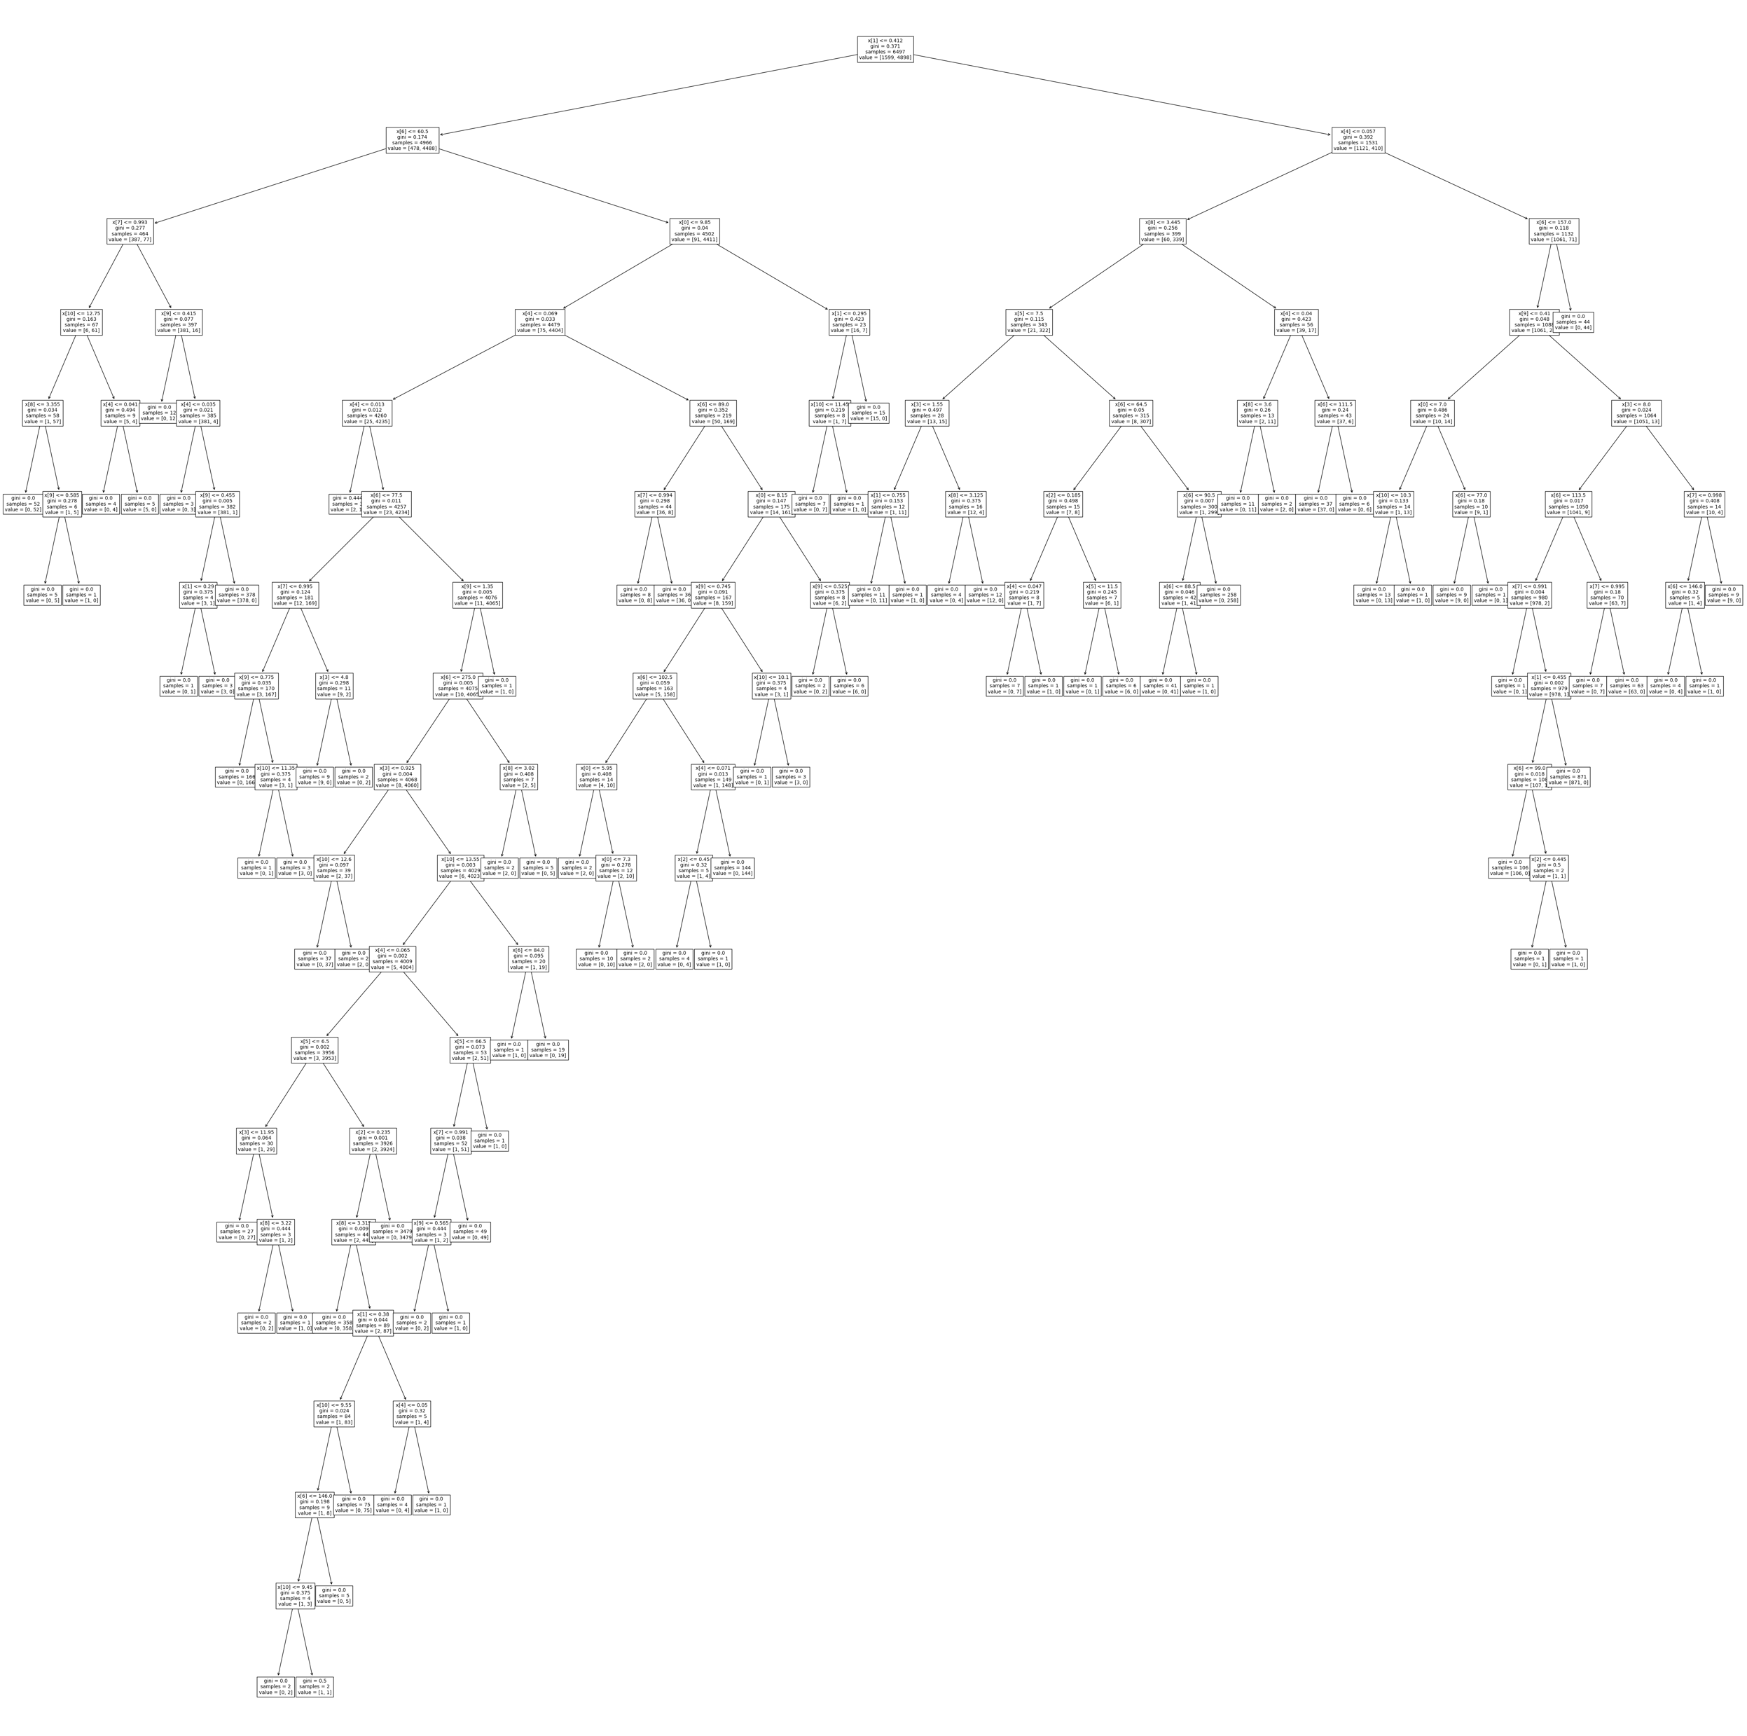
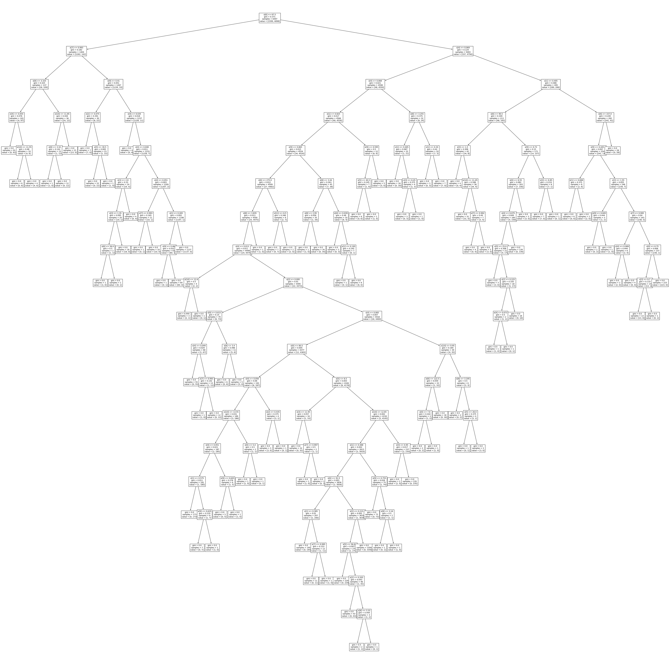
Decision Trees
diverse
What if we do it a lot?
26

Slide 27

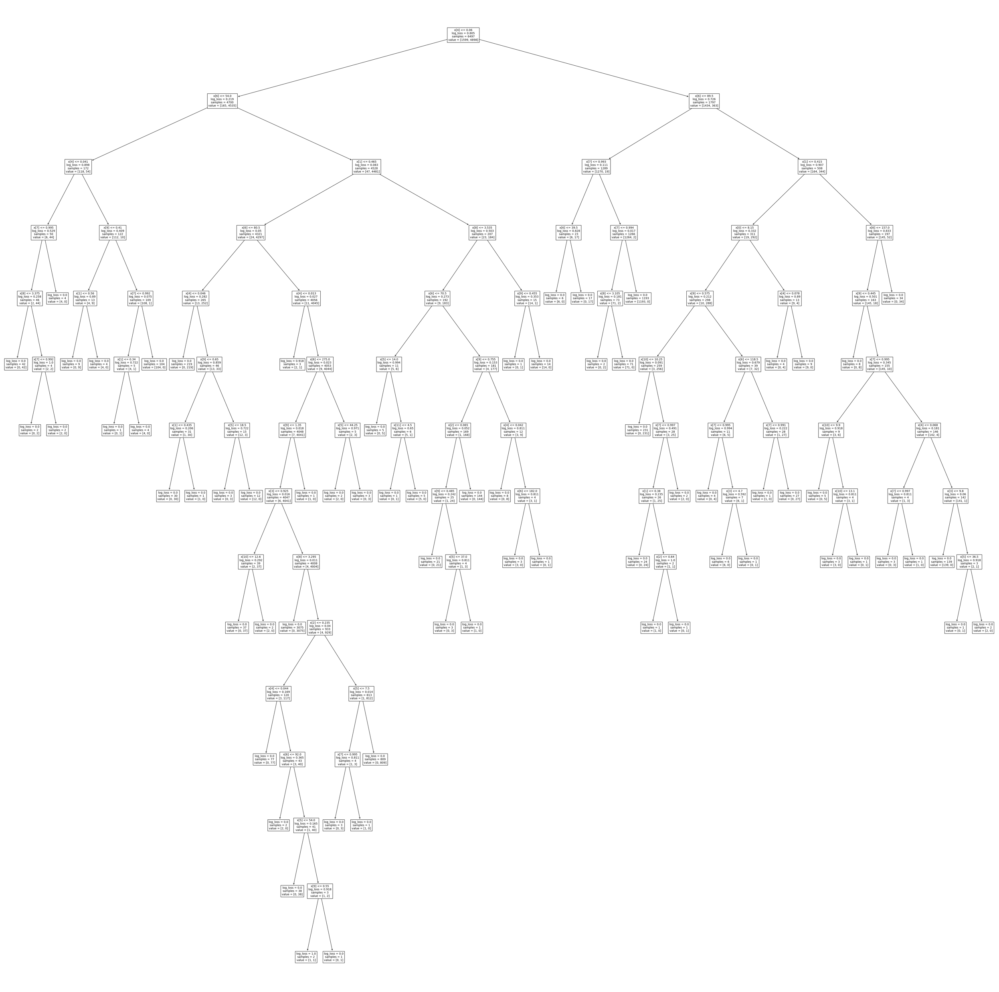





Decision Trees
Random Forest
Aye
Nay
Aye
Aye
Nay
Seal of Approval
Council of the Trees
AYE
Aye
Aye
Nay
Aye
Aye
27

Slide 28
Decision Trees
Make a lot of decision trees, on different portions of the data
For a new sample, run all of them
Combine their votes and take the majority
Random Forest
28

Slide 29
“split”
29

Slide 30
super
comfortable
Comfort
super
fashionable
“split”
Fashion
30
Notes:
So let’s take a closer look at what splits are. Here, our “bought” shoes are green and our “rejected” shoes are red. So here are some splits that we might do.

Slide 31
Comfort
“split”
Fashion
31

Slide 32
Comfort
this is fine, but…
???
“split”
Fashion
32
Notes:
But this doesn’t look great. What if we have a shoe here that we’re trying to predict?

Slide 33
Comfort
“split”
Fashion
we need a more complex split
Support vector machines!
33
Notes:
Our model tells us it’s a reject, but it’s not that bad. So we use a slanted line.

Slide 34
Support Vector Machines
Comfort
Fashion
34
Notes:
We want to make this slanted line as “splitting” as possible, meaning that we want it as far away from points as possible. So we want it to maximize the smallest distance.

Slide 35
Support Vector Machines
Comfort
Fashion
35
Notes:
Support vector machines help us maximize the smallest difference. This is our second type of model

Slide 36
Support Vector Machines
Comfort
Fashion
36

Slide 37
Support Vector Machines
Comfort
Fashion
37

Slide 38

Comfort
the “closest” points in different samples
38
Fashion
Notes:
Let’s look at the closest points.

Slide 39
Comfort
39
Fashion

Slide 40
Comfort
40
Fashion

Slide 41
Comfort
41
Fashion

Slide 42

Comfort
We gotta do better than this!
a good split maximizes distance between the split line and samples
$$min(\text{distance} \text{to} \text{line},\text{over} \text{all} \text{points})$$
We want to make this big!
42
Fashion
Notes:
The split we want is to have the closest points as far away as possible. So can we do better than this?

Slide 43

Support Vector Machines
Comfort
$$min(\text{distance} \text{to} \text{line},\text{over} \text{all} \text{points})$$
We want to make this big!
Fashion
43
Notes:
if we took this and (CLICK) stretched it

Slide 44
Support Vector Machines
Comfort
even better!
$$min(\text{distance} \text{to} \text{line},\text{over} \text{all} \text{points})$$
We want to make this big!
Fashion
44
Notes:
This curved line is even better, and SVMs (support vector machines) helps us do this.

Slide 45
Support Vector Machines
Comfort
even better!
$$min(\text{distance} \text{to} \text{line},\text{over} \text{all} \text{points})$$
We want to make this big!
support-vector machines are classifiers that divide data by class, aiming to create a margin that’s as wide as possible.
They can use non-linear functions
Fashion
45
Notes:
They do this using non-linear functions, like exponentials or polynomials.

Slide 46
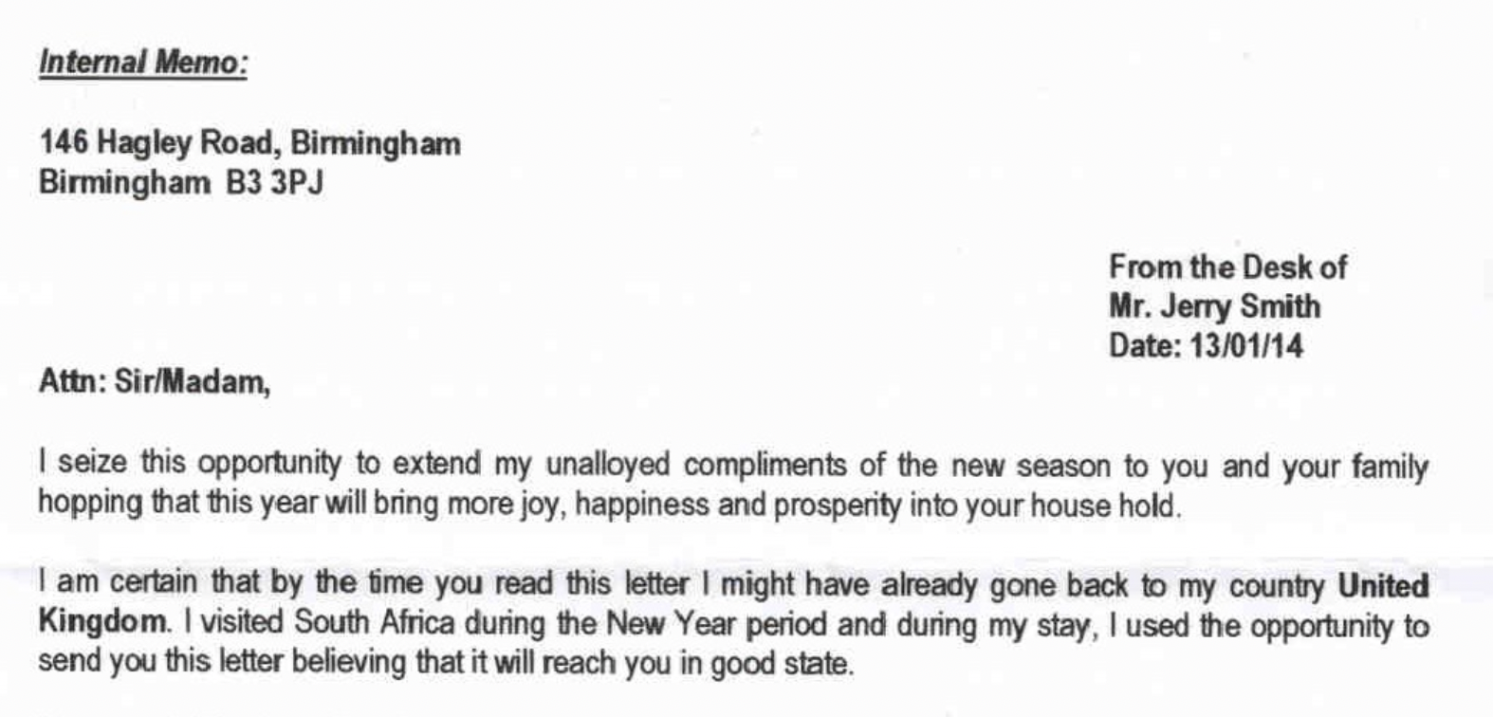
46
Notes:
Let’s say you have an email and you’re trying to detect if it’s spam or not.

Slide 47

“unalloyed complements”
Spam
“$100,000 dollars”
Spam
“relative dying of cancer”
Spam
47
Notes:
These things are usually associated with spam (if your relative is dying of cancer they will probably call you not email)

Slide 48
IF we have this
we get this
“unalloyed complements”
Spam
“$100,000 dollars”
Spam
“relative dying of cancer”
Spam
48
Notes:
And so if we have these things, then we have spam

Slide 49
we get this
IF we have this
49

Slide 50
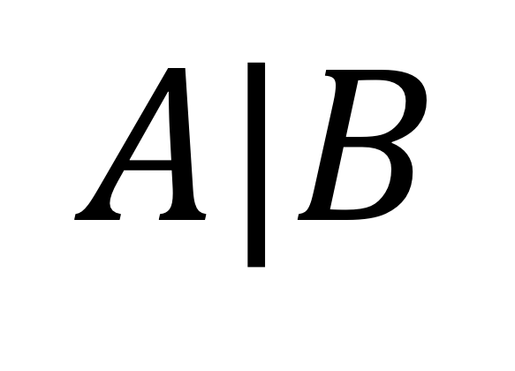
we get this
IF we have this
$$A|B$$
50
Notes:
And we can use this special notation here. A happening, if you are given, as a premise, B

Slide 51
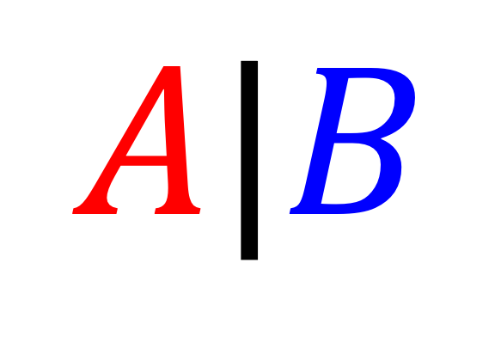
we get this
IF we have this
$$A|B$$
Is Spam
“Nigerian Prince”
51

Slide 52
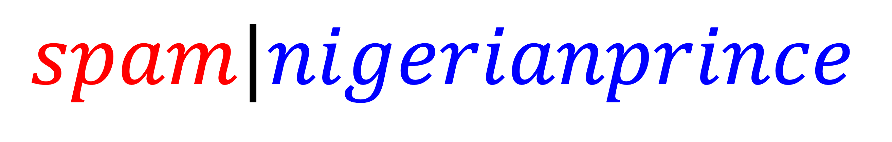
we get this
IF we have this
$$spam|nigerianprince$$
52

Slide 53

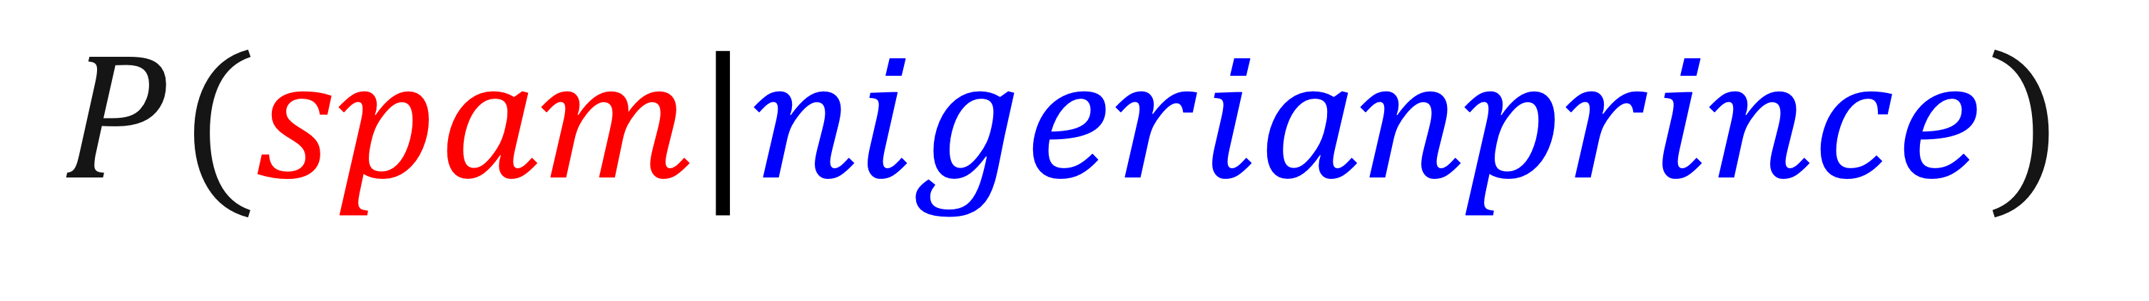
we get this
IF we have this
$$P(spam|nigerianprince)$$
high?
Nigerian prince
spam likely
low?
Nigerian prince
not spam
conditional probabilities can be used as a classifier!
53
Notes:
And so we can use the probability of spam given nigerian prince to tell us if “nigerian prince” tells us this is spam. If it is a high probability, then it will likely be spam. If it is a low probability, it will likely not be spam.

Slide 54



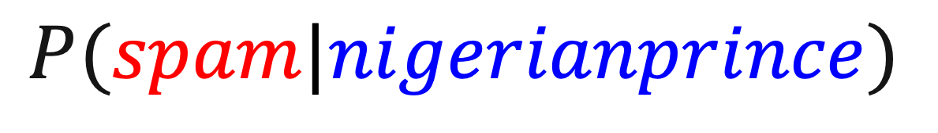
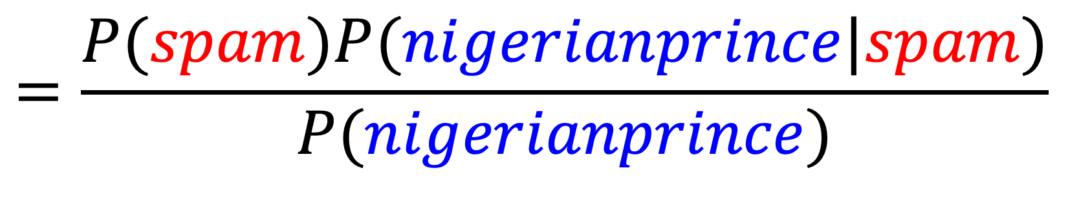
Naïve Bayes
% of spam in dataset that relates to Nigerian prince
Bayes Equation
% of spam in dataset
$$=\frac{P(spam)P(nigerianprince|spam)}{P(nigerianprince)}$$
$$P(spam|nigerianprince)$$
% of Nigerian prince in dataset
54
Notes:
Everything on the right side is directly observable in the dataset.
We multiply the percent of the dataset that is spam by the percent of spam that has the nigerian prince, and divide it by percent of the dataset that includes nigerian prince.

Slide 55
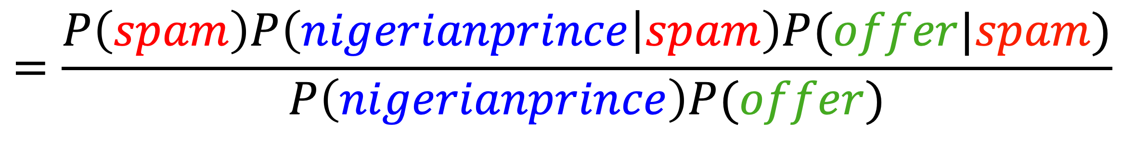
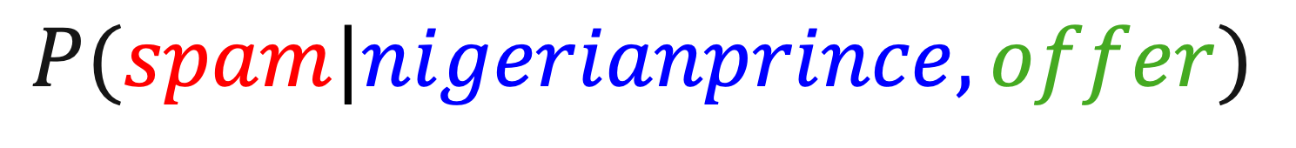
Naïve Bayes
Classifier
$$=\frac{P\left(spam\right)P\left(nigerianprince | spam\right)P(offer|spam)}{P\left(nigerianprince\right)P(offer)}$$
$$P(spam|nigerianprince,offer)$$
conditional probabilities can be used as a classifier!
a classifier made this way, however, is “naïve” when extended to multiple features
multiplication for AND assumes independence!
“naïve”
55
Notes:
And if we want more conditions involved, we just multiply. This is the Naïve Bayes classifier. It’s naïve because the multiplication assumes that the probabilities are independent (like to coin tosses) but they might be.

Slide 56


Naïve Bayes
Independence
50%
50%
50%
50%
56
Notes:
Everything on the right side is directly observable in the dataset.
We multiply the percent of the dataset that is spam by the percent of spam that has the nigerian prince, and divide it by percent of the dataset that includes nigerian prince.

Slide 57
Naïve Bayes
Independence
January 2nd
January 1st
50%
50%
50%
50%
57
Notes:
Everything on the right side is directly observable in the dataset.
We multiply the percent of the dataset that is spam by the percent of spam that has the nigerian prince, and divide it by percent of the dataset that includes nigerian prince.

Slide 58
Naïve Bayes
Independence
P(Rain | )
January 1st
P(Rain | )
January 2nd
=50%
=50%
58
Notes:
Everything on the right side is directly observable in the dataset.
We multiply the percent of the dataset that is spam by the percent of spam that has the nigerian prince, and divide it by percent of the dataset that includes nigerian prince.

Slide 59
Naïve Bayes
Independence
P(Rain | January 1st AND Rain | January 2nd)
=45%
Is NOT
P(Rain | )
January 1st
*
P(Rain | )
January 2nd
=25%
59
Notes:
Everything on the right side is directly observable in the dataset.
We multiply the percent of the dataset that is spam by the percent of spam that has the nigerian prince, and divide it by percent of the dataset that includes nigerian prince.

Slide 60
Naïve Bayes
Classifier
$$=\frac{P\left(spam\right)P\left(nigerianprince | spam\right)P(offer|spam)}{P\left(nigerianprince\right)P(offer)}$$
$$P(spam|nigerianprince,offer)$$
conditional probabilities can be used as a classifier!
a classifier made this way, however, is “naïve” when extended to multiple features
multiplication for AND assumes independence!
“naïve”
60
Notes:
And if we want more conditions involved, we just multiply. This is the Naïve Bayes classifier. It’s naïve because the multiplication assumes that the probabilities are independent (like to coin tosses) but they might be.

Slide 61
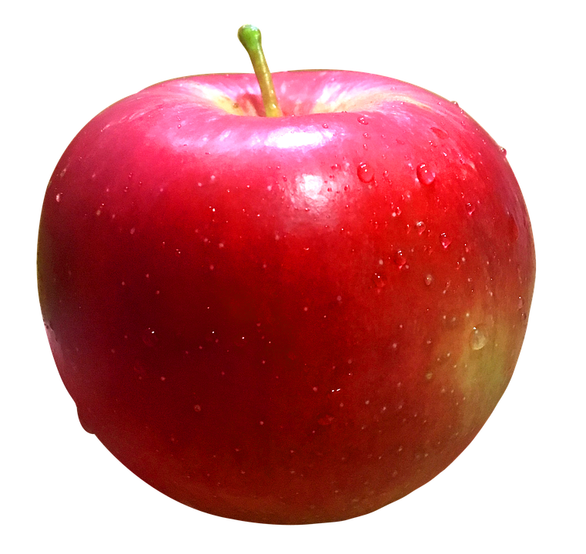
Buy?
Don’t buy?
61

Slide 62
Did Buy
Rejected
62

Slide 63
Previously accepted
Previously rejected
63

Slide 64
We find the
K Nearest Neighbors
More related
Previously accepted
Previously rejected
64

Slide 65



K Nearest Neighbors
Radius
Bounciness
65

Slide 66
K Nearest Neighbors
another hyperparameter
Radius
K=5
Buy
Bounciness
66

Slide 67
K Nearest Neighbors
another hyperparameter
Radius
K=7
Don’t Buy
Bounciness
67

Slide 68
K Nearest Neighbors
another hyperparameter
Radius
K=7
Don’t Buy
Bounciness
68

Slide 69
Feature Importance
69
Notes:
Let’s get to the lab

Slide 70
Feature Importance
1. Coefficients in linear regression models
2. feature_importances_ in RandomForest
3. permutation feature importance
Credit: https://inria.github.io/scikit-learn-mooc/python_scripts/dev_features_importance.html#
70

Slide 71
Feature Importance
Linear regression models
Predicting house price using a linear regression model
Inspect correlation between features and target
Build model, inspect coefficient
Coefficient: conditional dependence, not marginal dependence.
  Conditional: assuming all other features remain constant
Sign and scale of coefficient
Variability of coefficient
71
Notes:
Coefficients represent the relationship between the given feature 𝑋𝑖 and the target 𝑦, assuming that all the other features remain constant (conditional dependence). This is different from plotting 𝑋𝑖 versus 𝑦 and fitting a linear relationship: in that case all possible values of the other features are taken into account in the estimation (marginal dependence).
If you look at the sign of the coefficient, are you surprised. Why is the coefficient associated to AveRooms negative? Does the price of houses decreases with the number of rooms?

Slide 72
Feature Importance
Random Forest
Built-in feature_importances_ attribute.
how much this feature is used in each tree of the forest
Formally, the (normalized) total reduction of the criterion brought by that feature
72
Notes:
Coefficients represent the relationship between the given feature 𝑋𝑖 and the target 𝑦, assuming that all the other features remain constant (conditional dependence). This is different from plotting 𝑋𝑖 versus 𝑦 and fitting a linear relationship: in that case all possible values of the other features are taken into account in the estimation (marginal dependence).

Slide 73
Feature Importance
Permutation
Can be used for any models
Shuffle a feature value and see how the prediction changes
Notes:
  Unrealistic samples may happen (e.g., # of rooms < # of bedrooms)
  Can run multiple times for stability
  Train or test data?
  Can you drop a feature, train a new model, and compare the results as importance?
73
Notes:
Coefficients represent the relationship between the given feature 𝑋𝑖 and the target 𝑦, assuming that all the other features remain constant (conditional dependence). This is different from plotting 𝑋𝑖 versus 𝑦 and fitting a linear relationship: in that case all possible values of the other features are taken into account in the estimation (marginal dependence).

Slide 74
Feature Importance
Self quiz
With a same dataset, feature importance might differ if:
  a) we use two different models
  b) we use two different train/test split with a same model
  c) we use a same model with a different set of hyper-parameters
  d) we use a same model with the same set of hyper-parameters but a different random_state
74
Notes:
Multiple choice questions. Can choose as many as correct. I think all of them are right.

Slide 75
Feature Importance
Self quiz
In linear model, the feature importance:
  a) might be inferred from the coefficients
  b) might be infer by importance_permutation
  c) should have the same importance from coefficients and importance_permutation
75
Notes:
Multiple choice questions. Can choose as many as correct. The first two are correct.

Slide 76
Feature Importance
Self quiz
If two feature are the same (thus perfectly correlated)
  a) their feature importance will be the same
  b) their feature importance will be divided by 2
  c) only one will receive all the feature importance, the second one will be 0
  d) it depends
76
Notes:
Multiple choice questions. Can choose as many as correct. The answer is d

Slide 77
Feature Importance
Self quiz
To evaluate the feature importance for a specific model, one could:
  a) drop a column and compare the score
  b) shuffle a column and compare the score
  c) put all column to 0 and compare the score
  d) change a column value to random number and compare the score
77
Notes:
Multiple choice questions. Can choose as many as correct. The answer is b. d) might generate a lot of out of range unrealistic samples. So it is not desirable.

Slide 78
Feature Importance
Notes
Feature importance is for a given fitted model (including hyperparameters, data split), it is related to the data, but not necessarily reflect all information in the data
Different models can give you different feature importance.
Every model has its assumptions and limitations. Understand them and use with care.
Check with domain knowledge and/or common sense
78
Notes:
Multiple choice questions. Can choose as many as correct. The answer is b. d) might generate a lot of out of range unrealistic samples. So it is not desirable.

Slide 79
Five classifiers and feature importance!
Let’s get to the lab!
79
Notes:
Let’s get to the lab

